Slide 1
Software Design Pattern
Designing Robust, Scalable, and Clean Code Architectures

Slide 2

Table of Contents
SOLID Principle
Creational Design Patterns
Behavioral Design Patterns
Structural Design Patterns

Slide 3
Design Pattern
What is Design Pattern?
Design patterns are reusable solutions to common software design problems that help developers build cleaner and more maintainable systems. They provide templates for solving issues in object creation, structure, and behavioral. They can make your code more flexible , reusable and scalable.
What is Gang of Four (GOF)?
In 1994, Erich Gamma, Richard Helm, Ralph Johnson, and John Vlissides published the book “Design Patterns: Elements of Reusable Object-Oriented Software”. These authors are collectively called the Gang of Four (GOF).
They introduced the concept of design patterns in software development.
What does a Design Pattern do?
Solves recurring design problems
Improves code structure
Makes code flexible and reusable
Makes software easy to maintain and extend
Provides a proven solution, not trial-and-error

Slide 4
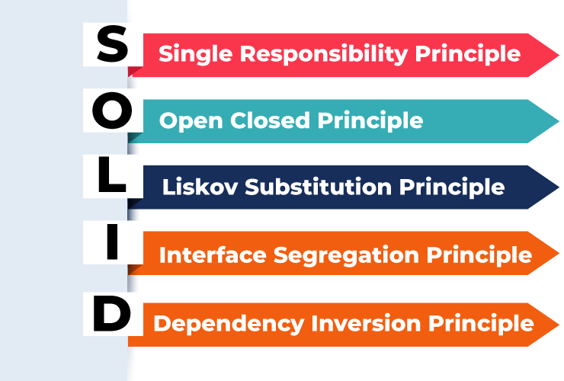
Solid Principles
SOLID is a set of five design principles that improve software design by making code maintainable, scalable, and flexible.
Why SOLID?
Encourages loose coupling between classes
Reduces dependency among components
Makes code reusable, stable, and easy to modify
Minimizes impact when changes are made in one part of the system
Loosely coupled classes ensure that changes in one class do not require changes in others, improving overall software quality.

Slide 5
Single Responsibility Principle
This principle states that a class should have only one reason to change, meaning it should be responsible for only one part of the software’s functionality.
In mathematical term,
Let C be a class and R(C) be the set of responsibilities handled by C.
R(C) = { r1, r2, …, rn }
According to SRP:
|R(C)| =1
A class should have exactly one responsibility.
Purposes:
Improves maintainability
Reduces side effects
Makes code easier to understand

Slide 6
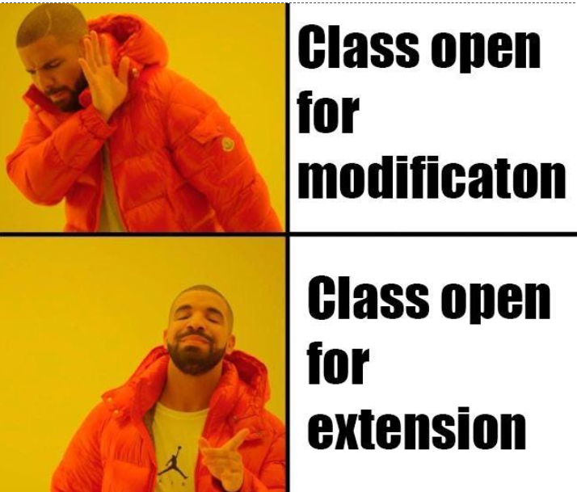
Open/Closed Principle
This principle states that "Software entities (classes, functions, etc.) should be open for extension, but closed for modification" which means we should be able to add new functionality without changing existing code
Let,
C = original class
B(C) = behavior of class C
ΔB = new behavior (extension)
OCP Formula: B(C_new) = B(C) + ΔB where C is unchanged
Purposes:
Prevent bugs by avoiding modifications to existing, tested code
Add new features without breaking current functionality
Reduce maintenance costs and development time
Enable easy scalability as requirements grow
Future-proof code against changing requirements

Slide 7
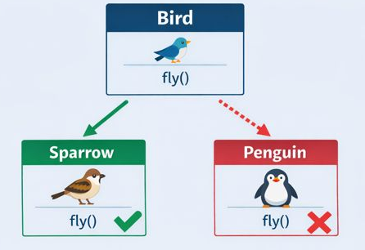
Liskov's Substitution Principle
Objects of a superclass should be replaceable with objects of a subclass without breaking the application or altering its correctness
Purposes:
Ensure subtypes can replace parent types without breaking functionality
Prevent unexpected bugs from polymorphic substitution
Maintain behavioral consistency across inheritance hierarchies
Enable reliable use of polymorphism and inheritance
Guarantee that derived classes honor the contract of base classes

Slide 8
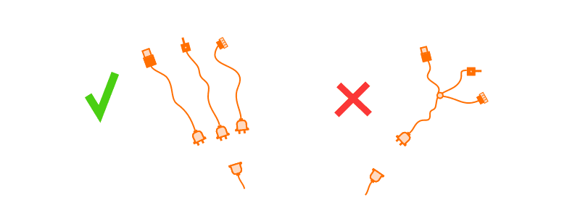
Interface Segregation Principle
No client should be forced to depend on interfaces or methods it does not use.
We should prefer many client interfaces rather than one general interface and each interface should have a specific responsibility
Purposes:
Prevent classes from implementing methods they don't need
Reduce coupling between classes and interfaces
Improve code maintainability and readability
Enable easier refactoring and system evolution
Avoid forcing clients to depend on unused functionality

Slide 9
Dependency Inversion Principle
High-level classes should not depend on low-level classes. Both should depend on abstractions. Abstractions should not depend on details. Details should depend on abstractions
H → A ← L
Where:
H depends on A (abstraction)
L implements A (abstraction)
H and L are decoupled through A
Instead of: HighLevel → LowLevel
Use: HighLevel → Interface ← LowLevel
Purposes:
Decouple high-level business logic from low-level implementation details
Make systems more flexible and easier to change
Enable easy testing through dependency injection and mocking
Reduce the impact of changes in low-level modules
Promote code reusability and modularity

Slide 10
Problems Without SOLID Principle
Code Rigidity : Small changes require modifying the entire system. One change breaks multiple unrelated parts, making the code inflexible and difficult to adapt to new requirements.
Tight Coupling : Classes are tightly interconnected and depend heavily on each other. It becomes impossible to modify one class independently without affecting the entire system, reducing flexibility.
Code Duplication: The same logic is written repeatedly across the codebase. This makes maintenance difficult, time-consuming, and increases the risk of inconsistent behavior throughout the application.
Difficult Testing: Unit testing becomes nearly impossible due to hard dependencies. Mock objects cannot be created for isolation, making automated testing and quality assurance impractical.
High Maintenance Cost : Bug fixing takes excessive time and resources. Development velocity slows down significantly, and adding new features becomes risky, increasing overall project costs and delays.

Slide 11
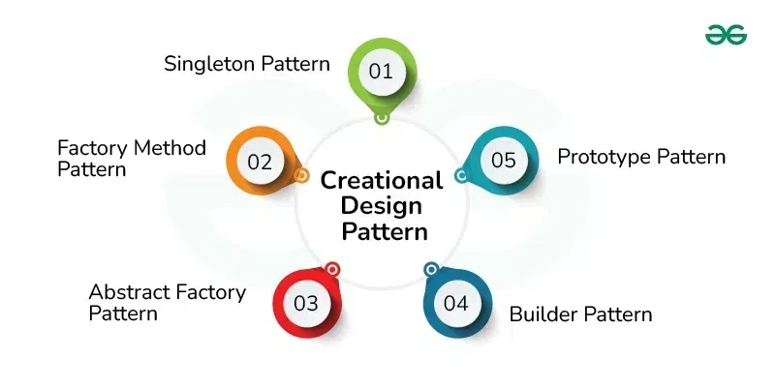
Creational Design Pattern
Creational Design Patterns deal with object creation mechanisms, trying to create objects in a manner suitable to the situation.
How, when, and by whom should an object be created?
Types of Creational Design Patterns
Singleton
Factory Method
Abstract Factory
Builder
Prototype

Slide 12
Singleton Pattern
Singleton is a creational design pattern that lets you ensure that a class has only one instance, while providing a global access point to this instance.
Benefits:
Ensures only one instance of a class exists.
Provides a global access point to the instance.
Helps in efficient resource management.
Supports lazy initialization (object created only when needed).
When to use:
Database Connection Manager – share a single DB connection.
Logger – centralized logging instance.
Configuration Manager – global access to app settings.
Caching – single cache instance for shared data.
Thread Pool / Resource Manager – manage limited resources safely.

Slide 13
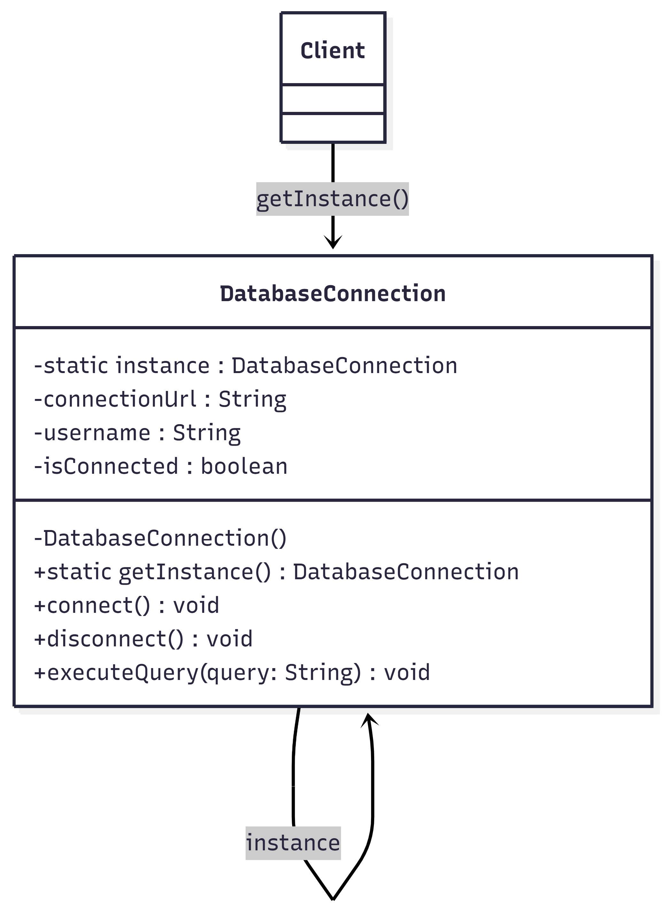
Singleton Pattern
Figure: Singleton Pattern UML Diagram

Slide 14
Factory Pattern
Factory Pattern creates objects without exposing the creation logic to the client. The client asks the factory for an object, and the factory decides which class to instantiate based on the given input. It is also known as Virtual Constructor.
Instead of calling constructors directly ( new ClassName() ), use a factory method that returns the appropriate object based on input parameters or conditions.
Client → Factory → Product Interface → Concrete Products
Benefits:
Allows factory to decide which object to create
Promotes loose coupling
Makes code easier to extend and maintain
Centralizes object creation logic in one place
When to use:
When a class does not know which type of object it need
When object creation logic should be centralized
When you want to follow the Open/Closed Principle

Slide 15
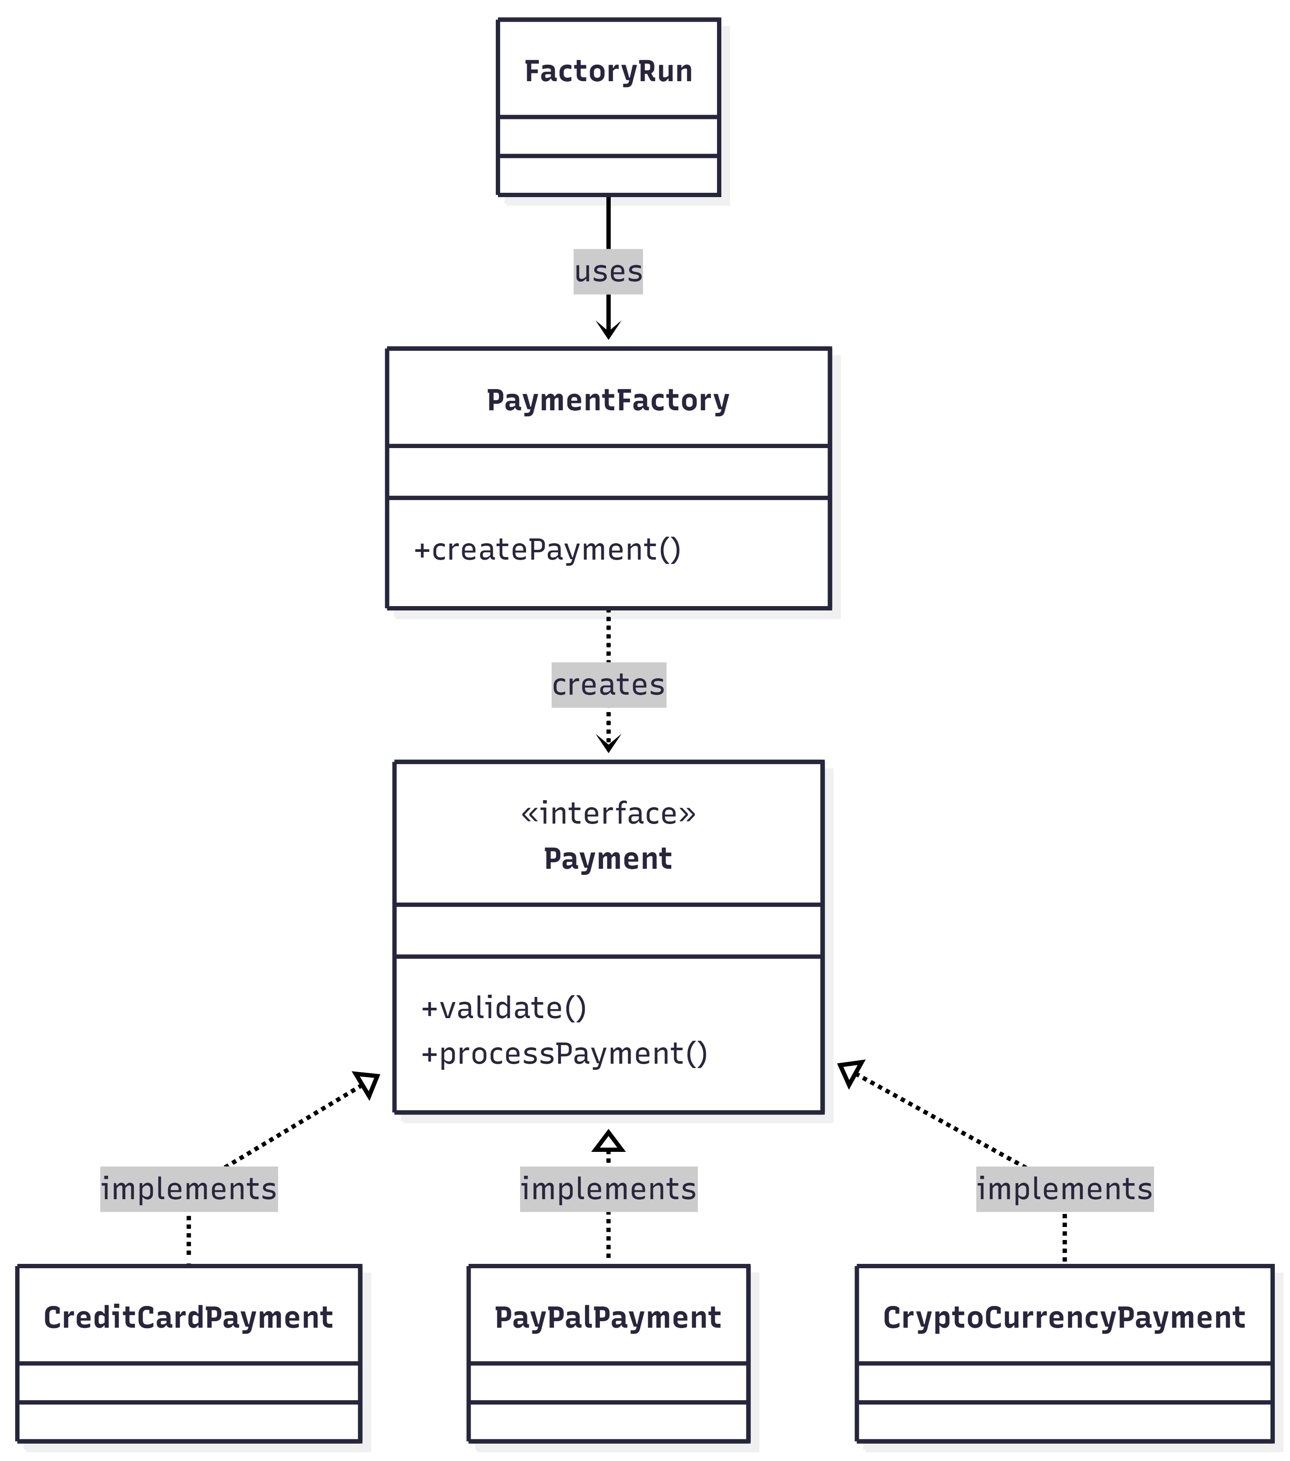
Factory Pattern
Figure: Factory Pattern UML Diagram

Slide 16
Abstract Factory Pattern
It is creational pattern that creates families of related objects through a common factory interface. The client receives a complete set of compatible products without knowing their concrete implementations
Instead of creating individual objects, Abstract Factory creates entire families of related objects that work together. It ensures all created objects belong to the same family and are compatible with each other.
Client → Abstract Factory Interface → Concrete Factories → Concrete Products
Key Components
Abstract Factory : Interface for creating families of related objects
Concrete Factory: Implements abstract factory to create specific product families
Abstract Product: Interface for related products that work together
Concrete Product: Actual implementation of a product in a family
Client: Uses abstract interfaces without knowing concrete implementations

Slide 17
Abstract Factory Pattern
Benefits:
Ensures products from the same family work together consistently
Isolates concrete classes from client, promoting loose coupling
Makes switching product families easy without changing client code
Maintains consistency among related products
Follows Open/Closed Principle - easy to add new families
When to use:
System needs independence from product creation and composition
System must work with multiple families of related products
Related products must be used together (enforcement required)
Need to provide a product library without exposing implementations
Need to switch between different product families at runtime

Slide 18
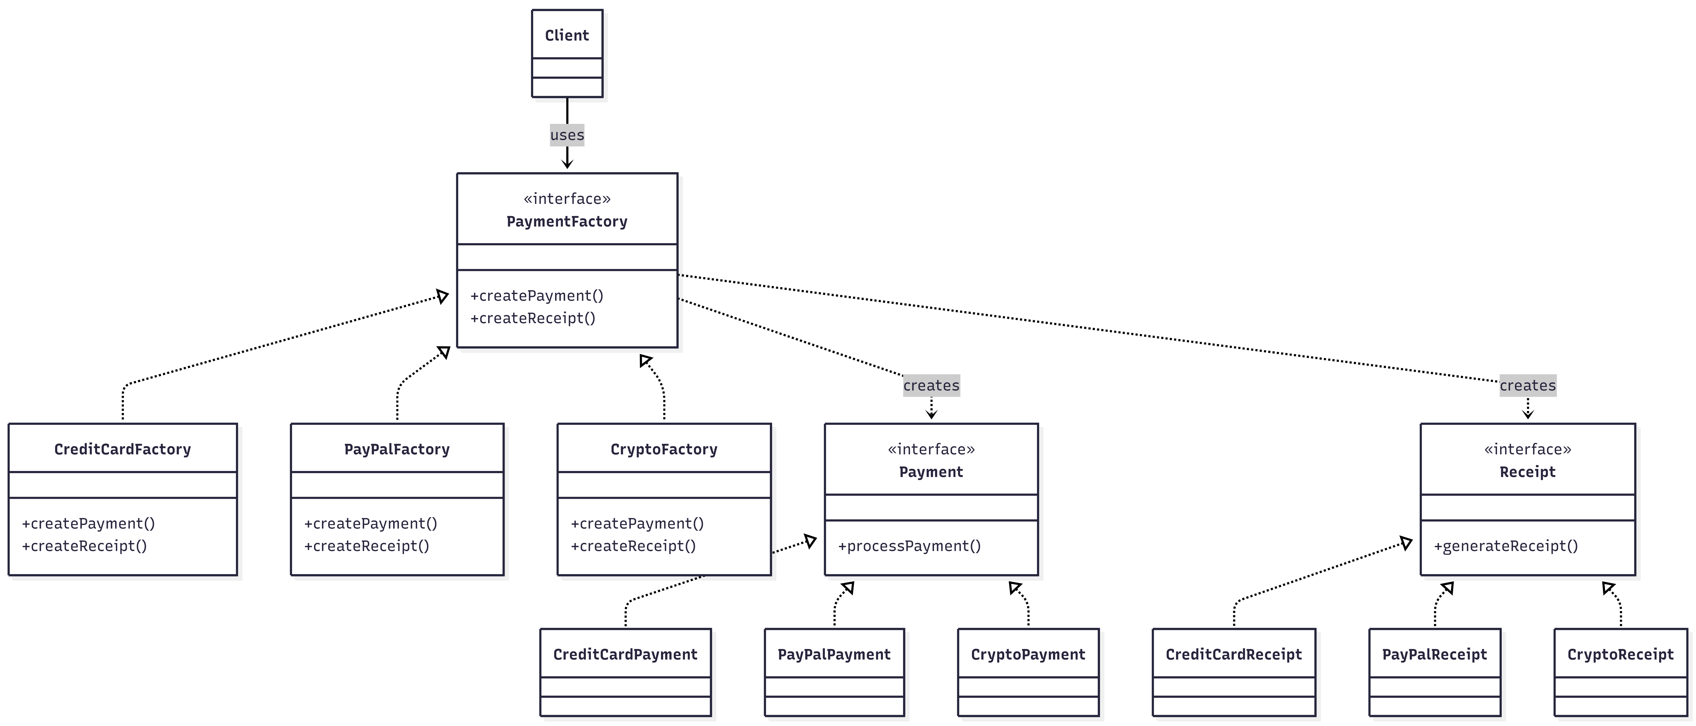
Abstract Factory Pattern
Figure: Factory Pattern UML Diagram

Slide 19
Prototype Pattern
Prototype pattern allows us to create new objects by copying existing objects (prototypes) rather than creating them from scratch. It's like using a photocopy machine instead of writing documents by hand!
Benefits:
Fast object creation by cloning instead of creating from scratch
Avoids complex initialization by copying already configured objects
Reduces subclassing by eliminating need for factory hierarchies
Allows dynamic configuration at runtime
Hides complexity from client code
When to use:
Object creation is expensive (database queries, file loading, network calls)
Need many objects with similar configurations
Want to avoid subclassing just for object creation
Object initialization is complex and time-consuming
Need to create objects whose type is unknown at compile time

Slide 20
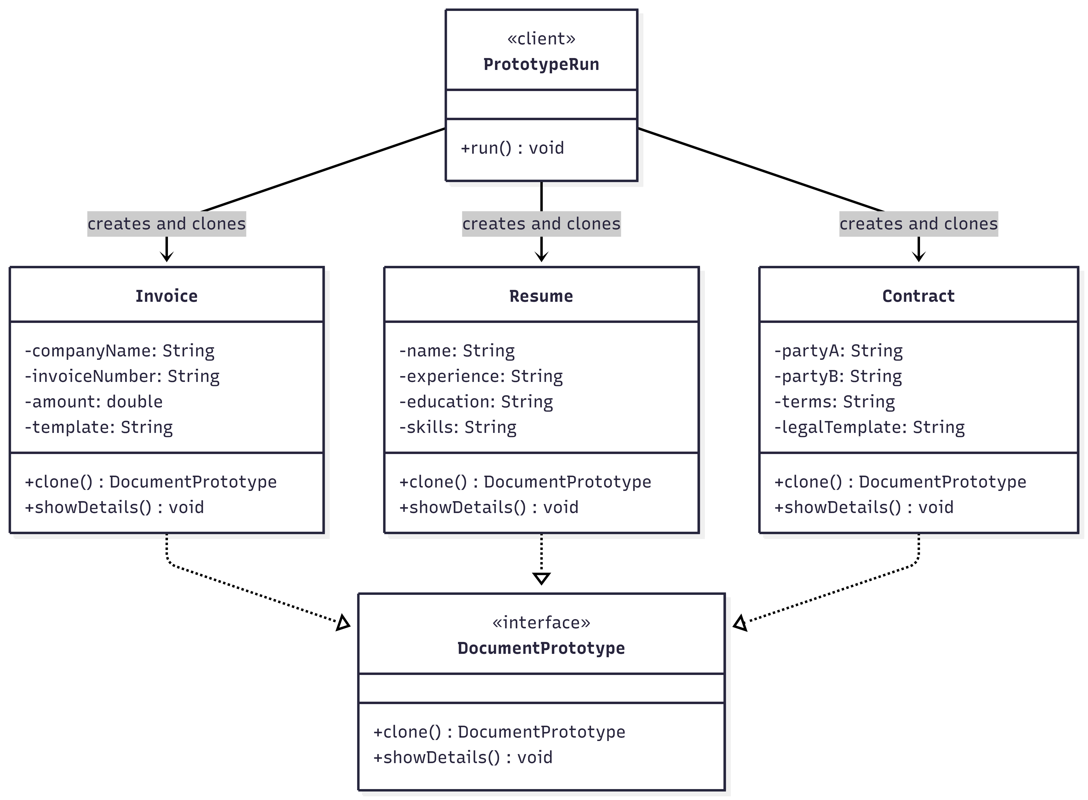
Prototype Pattern
Figure: Prototype Pattern UML Diagram

Slide 21
Builder Pattern
Builder Pattern allows us to build complex objects piece by piece. Instead of passing many parameters to a constructor, we can set each property step by step in a clear and readable way
Benefits:
Improves code readability
Handles complex object creation
Avoids long and confusing constructors
Supports immutable objects
Step-by-step object construction
Easy to extend and maintain
When to use :
Objects have many parameters
Some parameters are optional
Constructors become hard to read and maintain
Prevents telescoping constructor problem
Want to make object immutable after creation

Slide 22
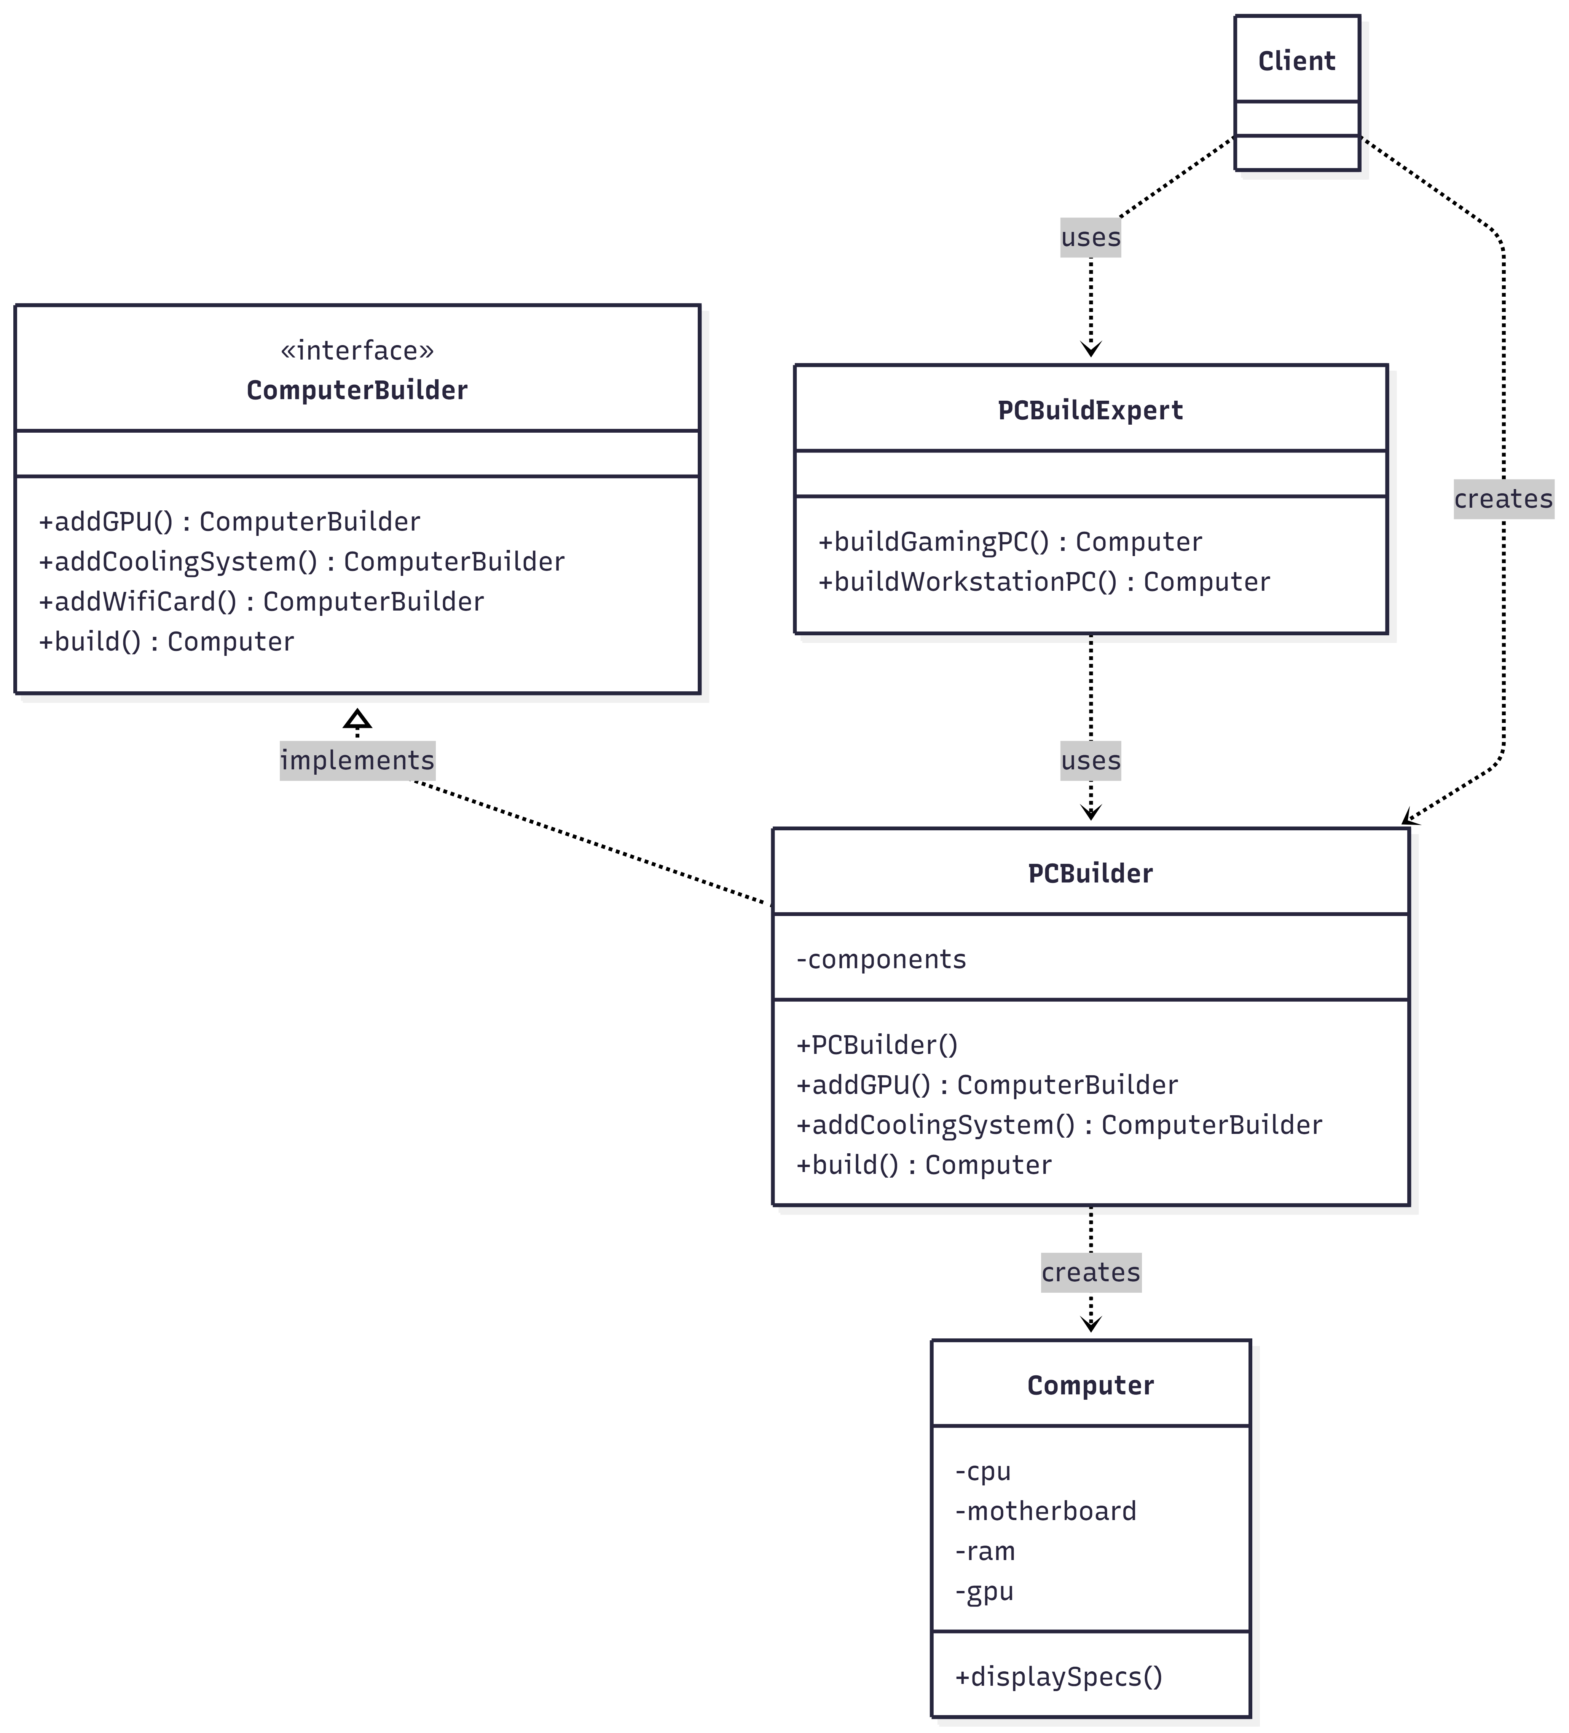
Builder Pattern
Figure: Prototype Pattern UML Diagram

Slide 23
Behavioral Design Pattern
Behavioral design patterns are design patterns that focus on how objects communicate and interact with each other.
Key Characteristics;
Focus on Communication Define how objects interact and share responsibilities with each other
Flexible and Dynamic Behavior Allow behavior or algorithms to change dynamically at runtime
Promote Loose Coupling Reduce tight dependencies by controlling how objects communicate
Here are the behavioral design patterns:
Chain of Responsibility
Command
Iterator
Mediator
Memento
Observer
State
Strategy
Template Method
Visitor

Slide 24
Chain of Responsibility Pattern
Chain of Responsibility allows you to pass a request through a chain of handlers. Each handler decides either to process the request or pass it to the next handler in the chain.
Benefits:
Loose Coupling - Sender doesn't know who handles the request
Flexibility - Easy to add/remove handlers
Single Responsibility - Each handler has one job
Dynamic Chain - Can change the chain at runtime
When to use:
When multiple objects can handle a request
When the handler is not known in advance
When you want to pass a request through a chain of handlers
When you want to avoid tight coupling between sender and receiver
When request processing needs to follow a sequence or pipeline
Chain of Responsibility = Pass request along handlers until one handles it

Slide 25
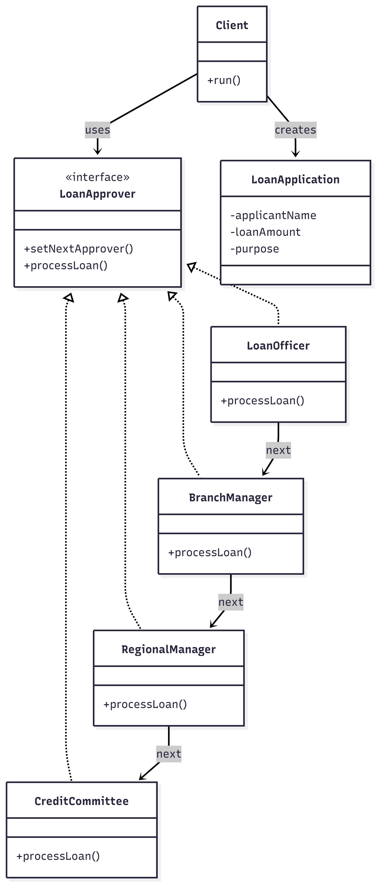
Chain of Responsibility Pattern
Figure: Chain of Responsibility Pattern UML Diagram

Slide 26
Command Pattern
Command Pattern turns a request or action into an object, so the sender does not need to know how the request is executed or who executes it.
Benefits:
Loose coupling between sender and receiver
Makes it easy to add new commands without changing existing code
Supports undo / redo functionality
Allows command queuing and logging
Improves code clarity and maintainability
When to use :
When you want to decouple the requester from the executor
When you need to queue, schedule, or log operations
When you want to support undo and redo
When multiple commands can be executed in a uniform way

Slide 27
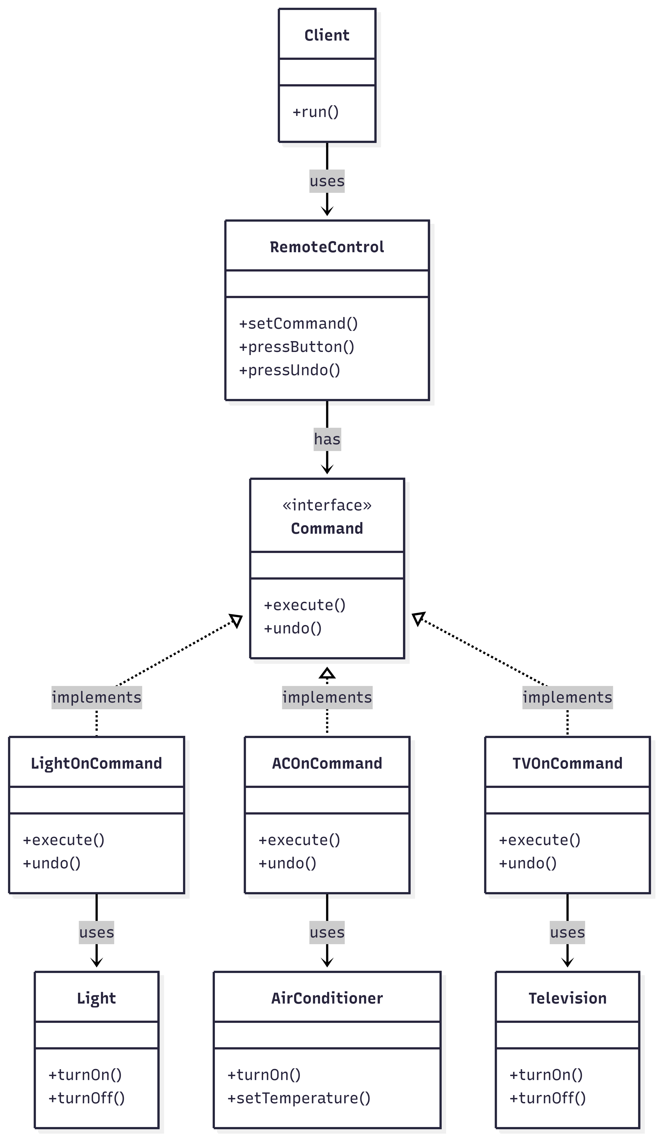
Command Pattern
Figure: Command Pattern UML Diagram

Slide 28
Strategy Pattern
Strategy Design Pattern is a behavioral design pattern that allows you to define a family of algorithms or behaviors strategies, put each of them in a separate class, and make them interchangeable at runtime. This pattern is useful when you want to dynamically change the behavior of a class without modifying its code.
Benefits:
Runtime flexibility change algorithm dynamically
Eliminates if–else logic each strategy is a separate class
Easy to extend add new strategies without modifying existing code
Encapsulation each algorithm is independent and self-contained
Follows Open Closed Principle open for extension closed for modification
Improves maintainability and readability
When to use:
When you have multiple algorithms to perform the same task
When the algorithm must be selected at runtime
When you want to avoid large if–else or switch statements
When different behaviors share the same interface
When algorithms may change or grow in the future
Strategy Pattern = Select behavior at runtime

Slide 29
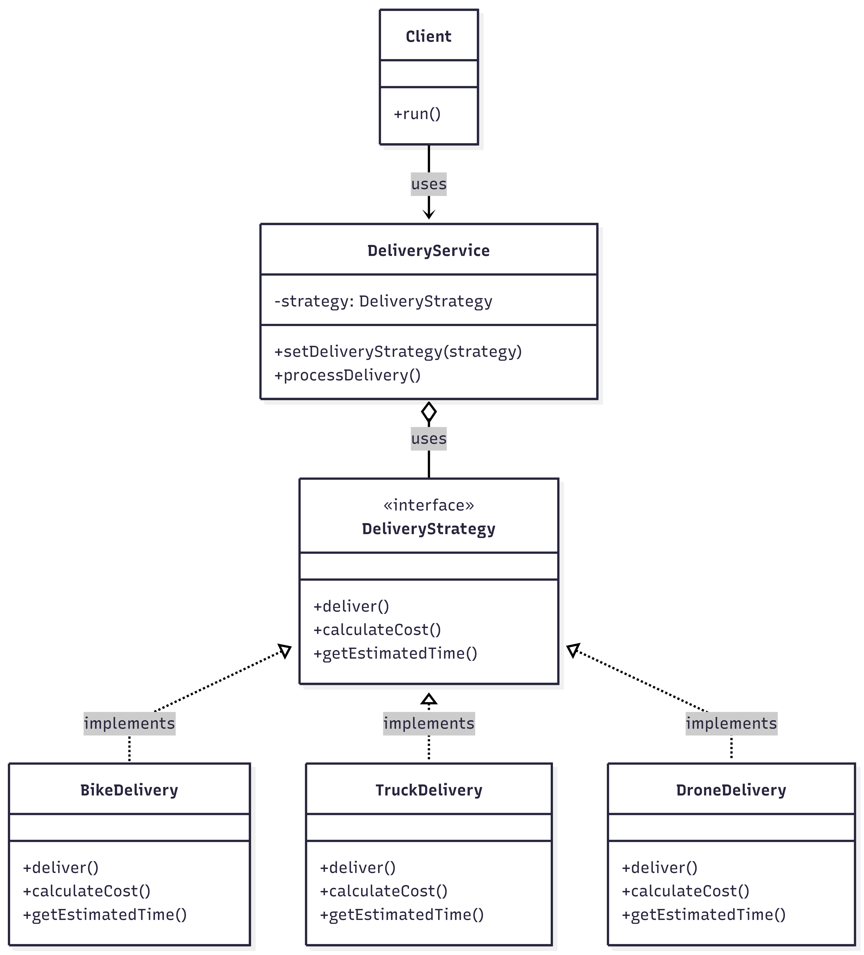
Strategy Pattern
Figure: Strategy Pattern UML Diagram

Slide 30
Observer Pattern
Observer Pattern defines a one-to-many dependency between objects so that when one object (Subject) changes state, all its dependent objects (Observers) are notified and updated automatically.
Components:
Subject - The object being observed (maintains list of observers)
Observer - Objects that want to be notified of changes
Concrete Subject - Implements subject, holds the state
Concrete Observers - Implements observer, receives updates
When to use :
When changes to one object require changing multiple objects
When an object should notify others without knowing who they are
When you need a broadcast communication mechanism
When objects should be loosely coupled
When observers can be added/removed dynamically at runtime

Slide 31
Observer Pattern
Benefits:
Subject and observers are loosely coupled
Observers can be added or removed at runtime
One state change notifies multiple observers
New observers can be added without modifying existing code
Subjects and observers can be reused independently
New observer types can be added easily

Slide 32
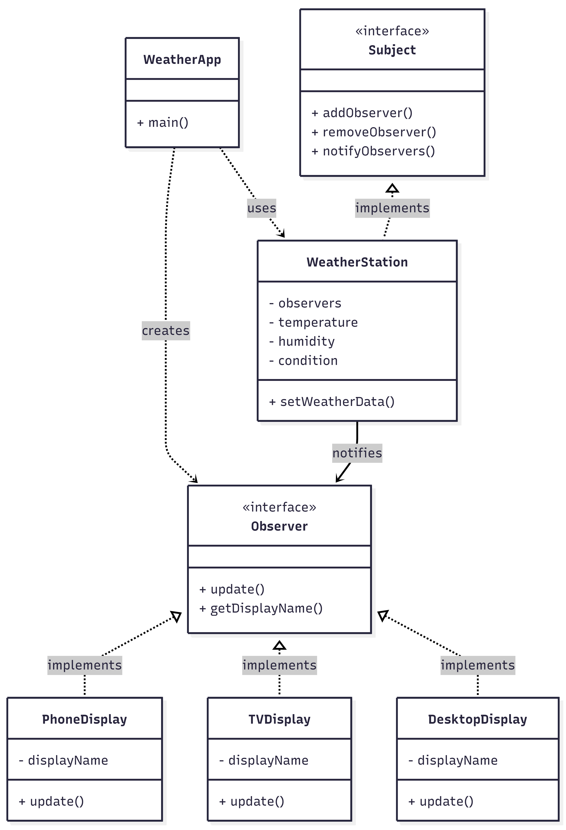
Observer Pattern
Figure: Observer Pattern UML Diagram

Slide 33
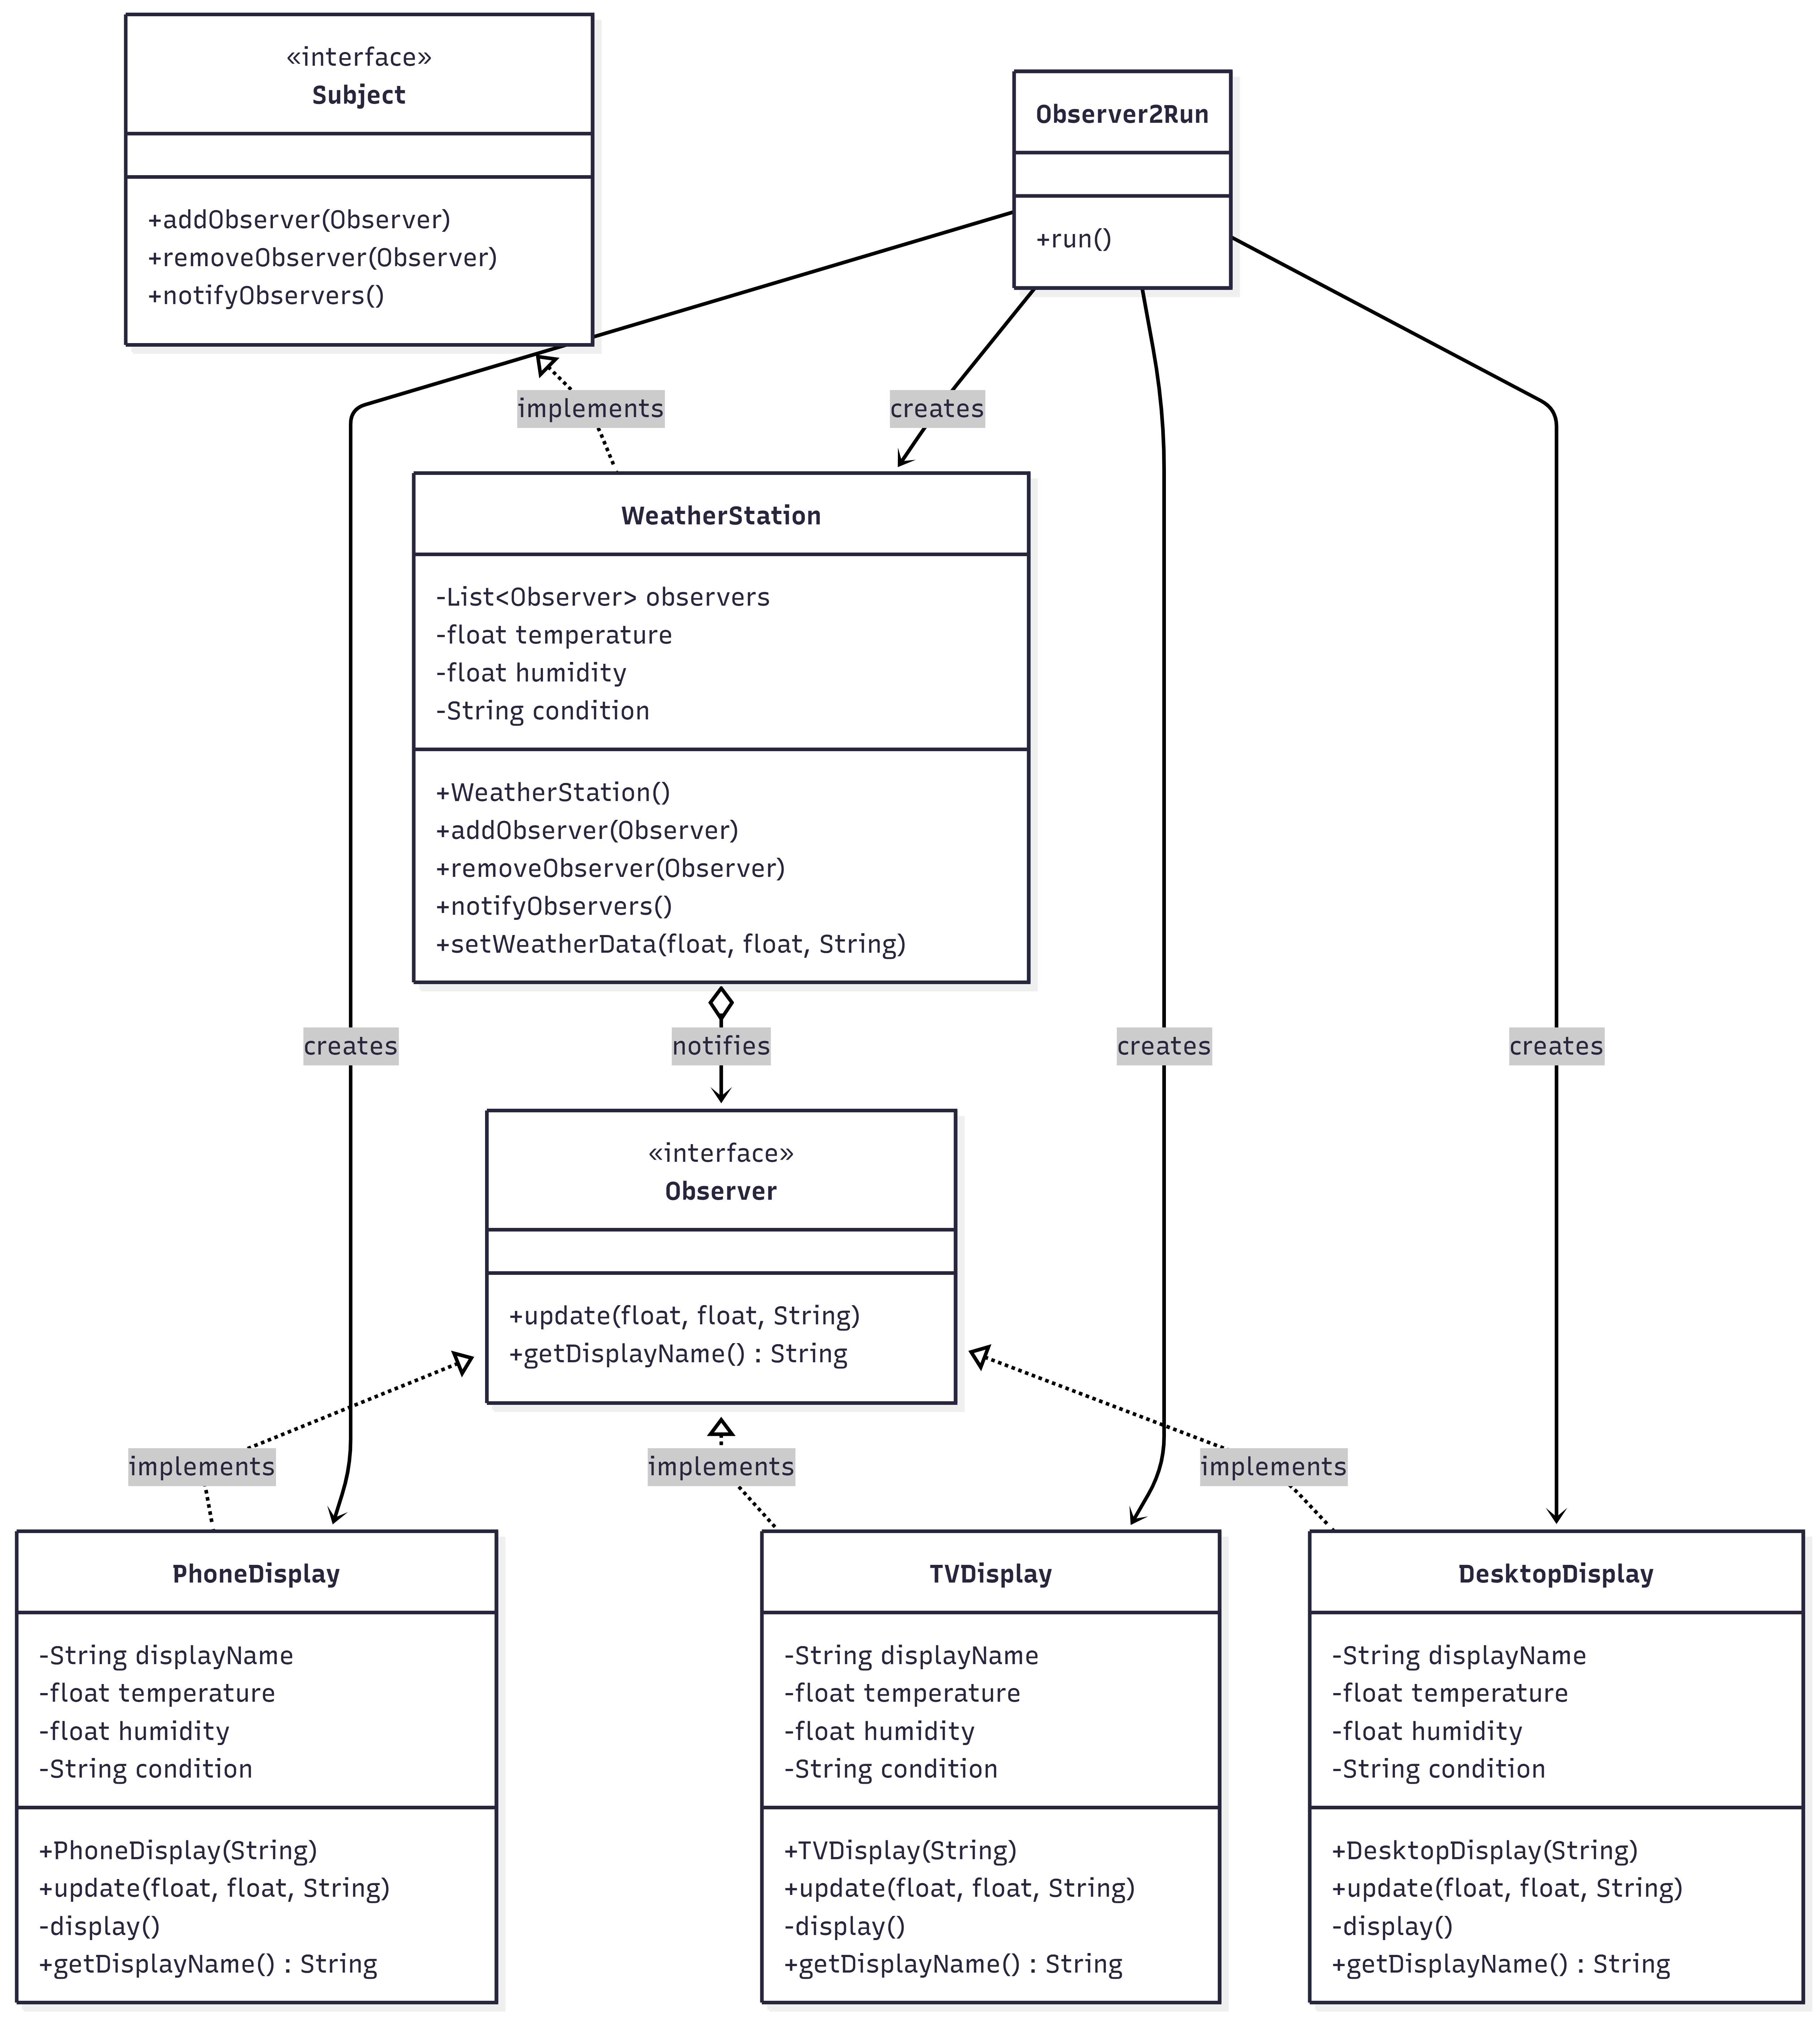
Observer Pattern
Figure: Observer Pattern UML Diagram

Slide 34
Iterator Pattern
Iterator Pattern provides a way to access elements of a collection sequentially without exposing the underlying representation (like array, list, etc.).
When to use :
When you need to traverse a collection without exposing its internal structure
When different collections should be traversed in the same way
When traversal logic should be separated from the collection logic
When multiple traversals are needed at the same time
When the internal data structure may change in the future
Benefits:
Uniform access to traverse collections
Hides internal data structure (encapsulation)
Supports multiple iterators at the same time
Allows changing internal storage without client impact
Separates data storage from traversal logic (SRP)

Slide 35
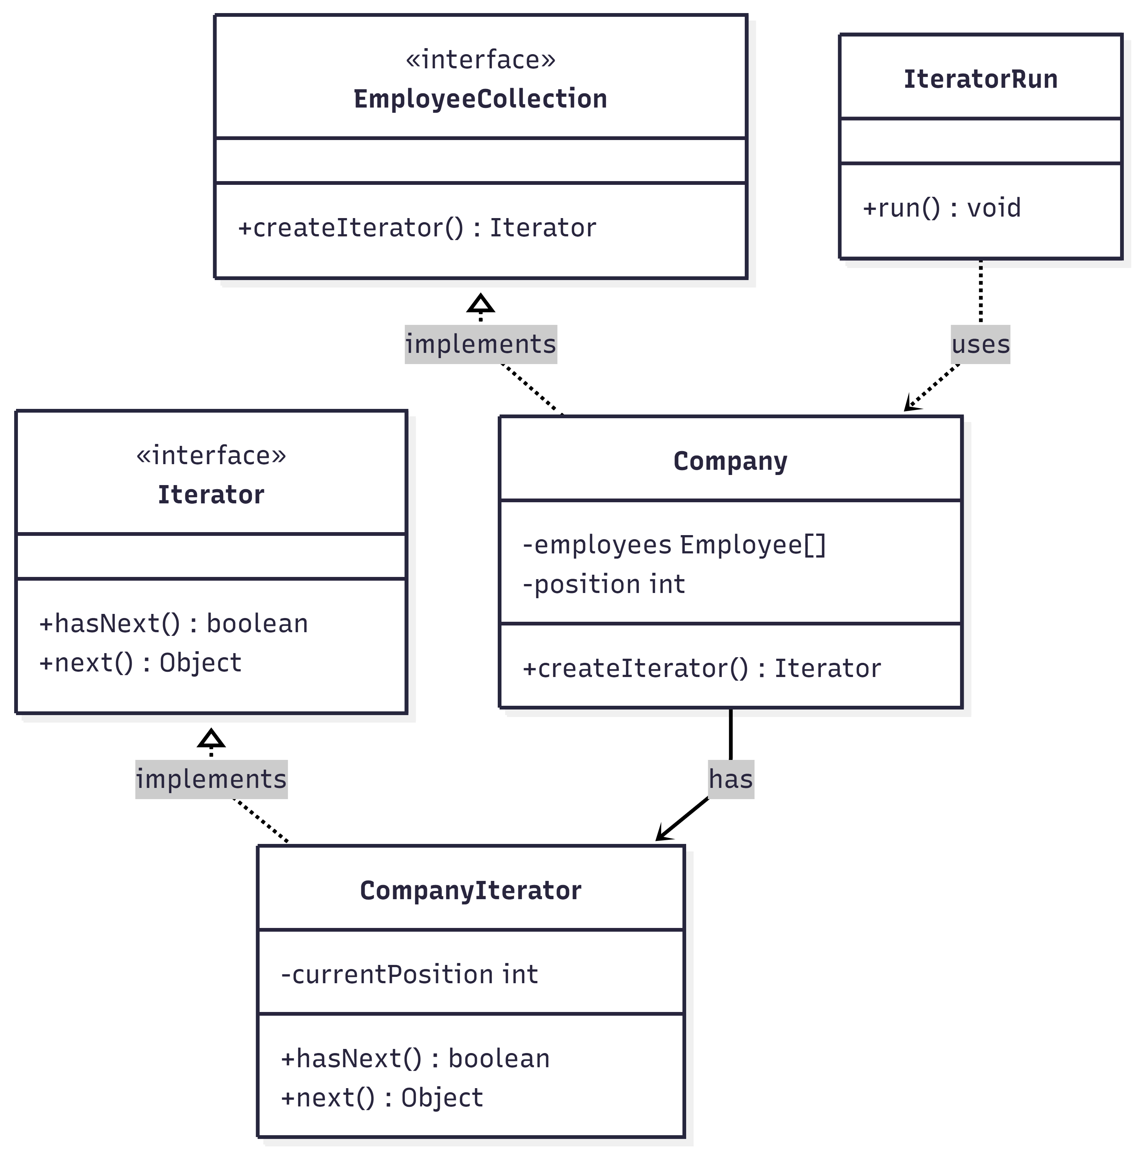
Iterator Pattern
Figure: Iterator Pattern UML Diagram

Slide 36
Template Pattern
Template Method Design Pattern is a behavioral pattern that defines the skeleton of an algorithm in a base method while allowing subclasses to override specific steps without altering its overall structure. It’s like a recipe: the main steps remain fixed, but details can be customized for variation.
Benefits:
Reuse common code across subclasses
Maintain consistent algorithm structure
Customize only specific steps in subclasses
Easy maintenance: template updates apply to all
Encapsulate invariant behavior in base class
When to use:
Framework development: Where some steps are fixed, some customizable (Spring, Android)
Data processing: Follows Read data → Process → Write pattern
Game development: Game loop where initialize → play → end structure is same
Network communication: Connection open → Data send → Connection close
Report generation: Different formats (PDF, Excel, HTML) but same process

Slide 37
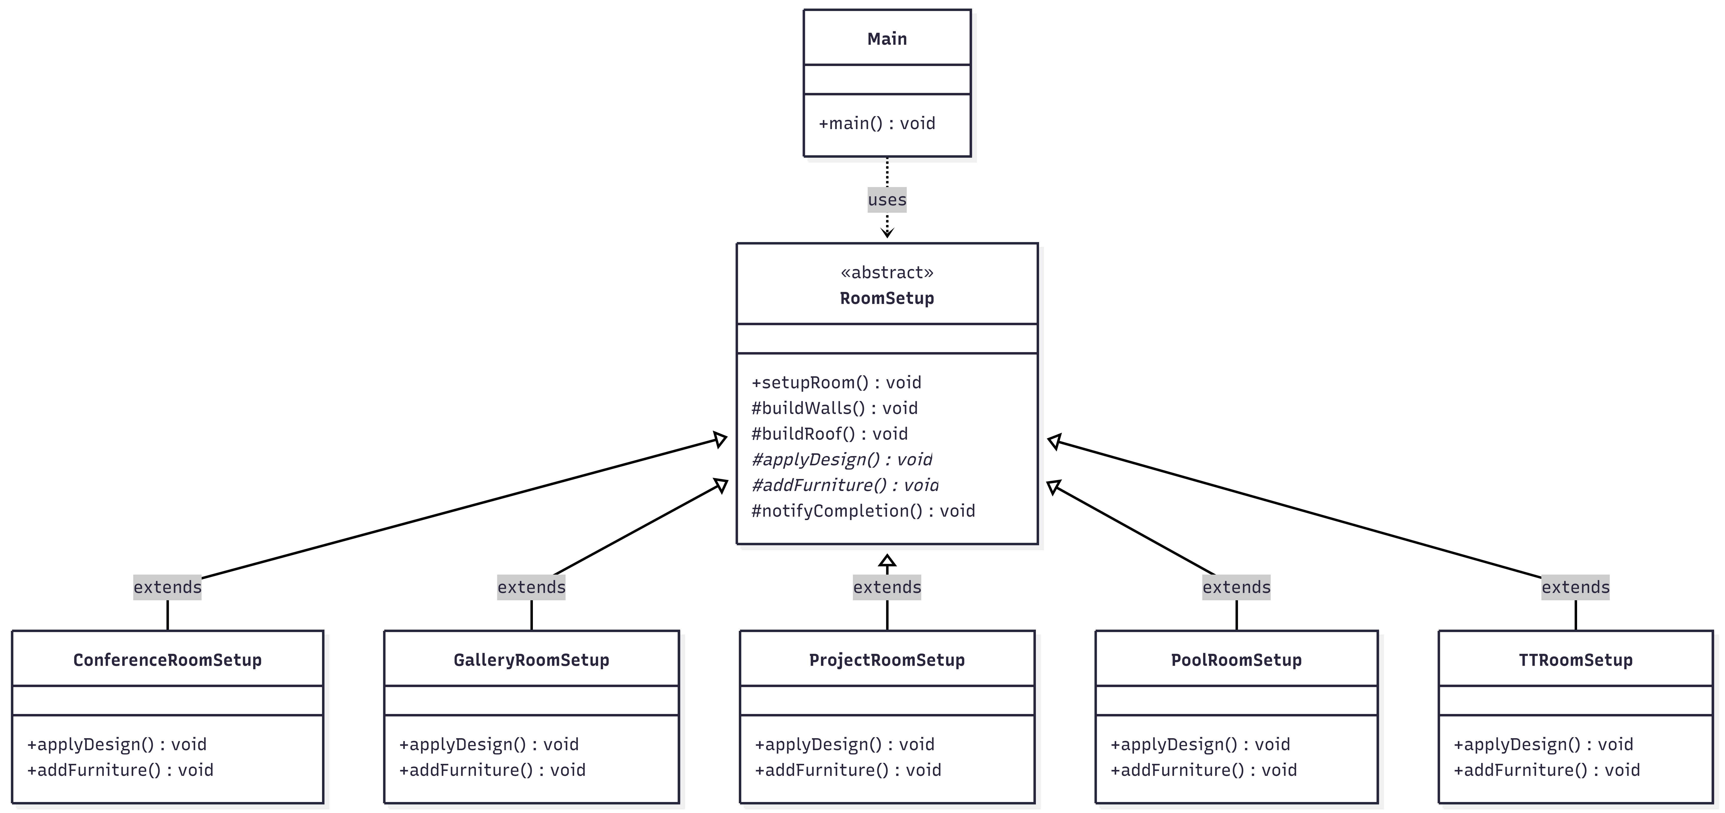
Template Pattern
Figure: Template Pattern UML Diagram

Slide 38
Memento Pattern
The Memento Design Pattern is a behavioral pattern that helps save and restore an object's state without exposing its internal details. It is like a "snapshot" that allows you to roll back changes if something goes wrong. It is widely used in undo-redo functionality in applications like text editors or games
Key Components:
Memento - Stores the snapshot of the object's state
Originator - The object whose state needs to be saved/restored
Caretaker - Manages and keeps track of multiple mementos (history)
Benefits:
Preserve object state without breaking encapsulation
Simplify originator by offloading state management
Support undo/redo operations
Enable rollback or snapshot functionality
Usages:
Text editors (undo/redo changes)
Graphics/drawing apps (undo drawing operations)
Games (save/load progress or checkpoints)
Database transactions (rollback, savepoints)

Slide 39
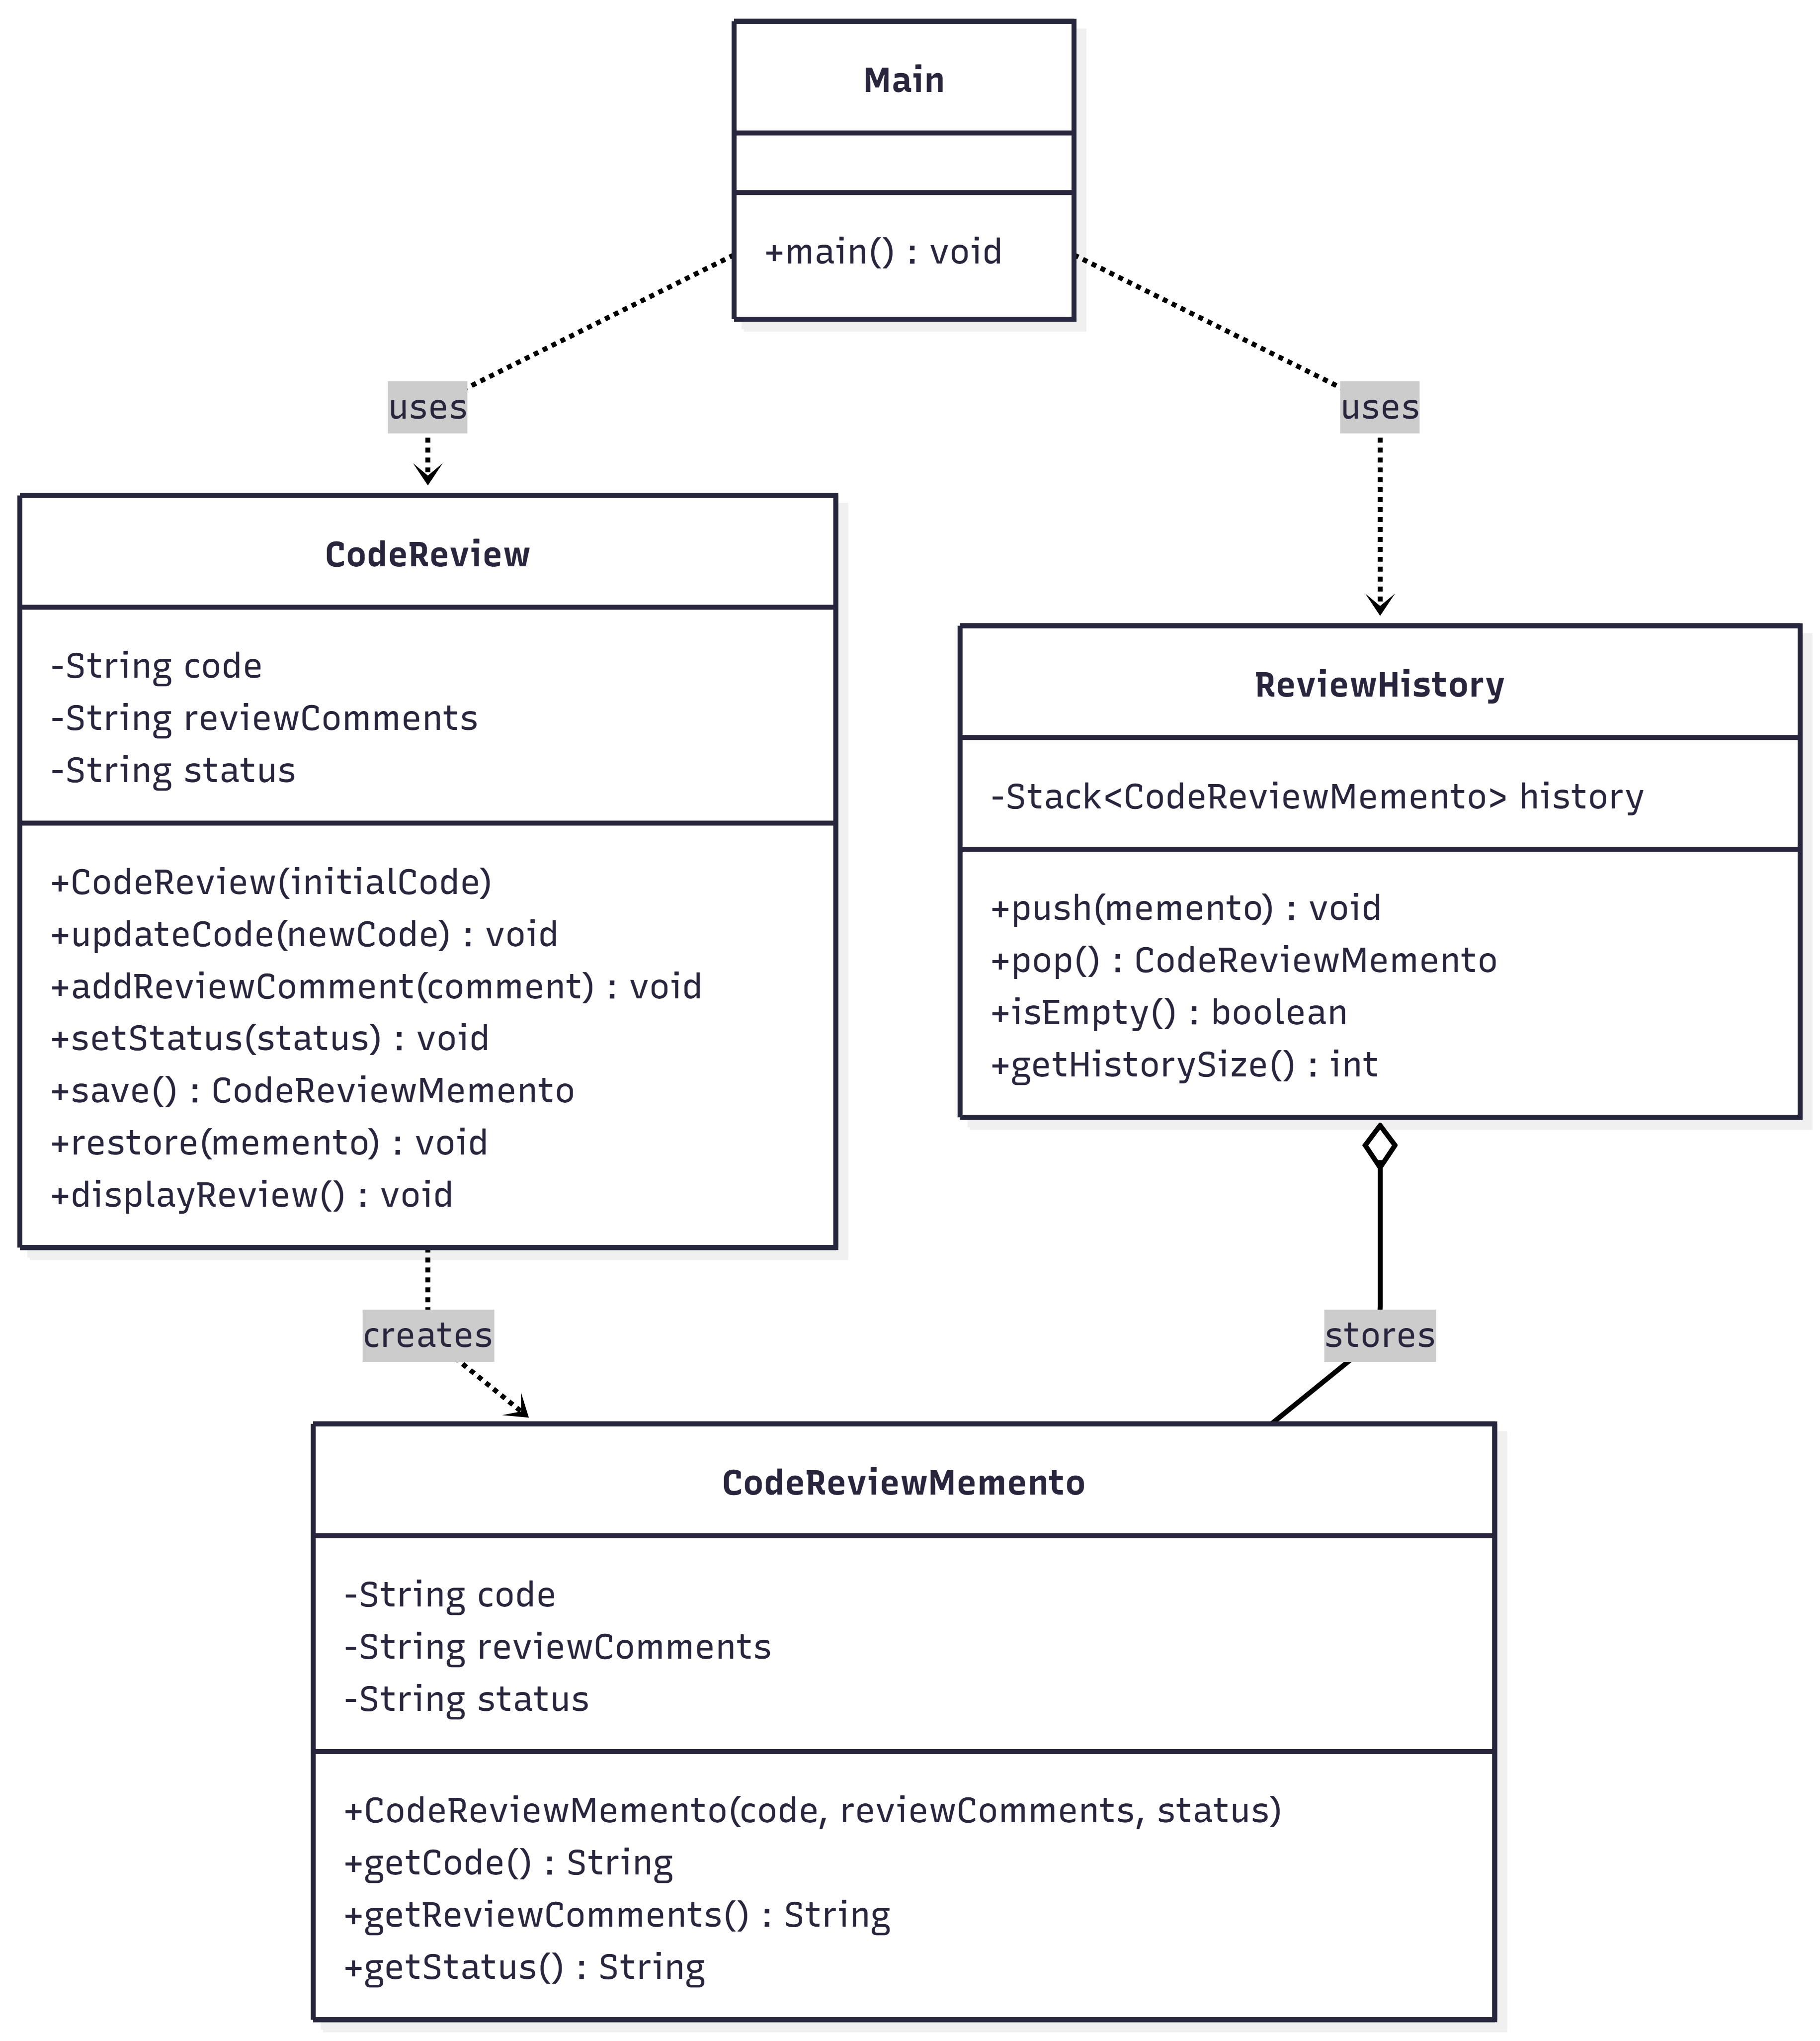
Memento Pattern
Figure: Memento Pattern UML Diagram

Slide 40
Mediator Pattern
The Mediator Pattern is a behavioral design pattern that defines an object (mediator) that controls how a set of objects interact with each other. Instead of objects communicating directly with each other, they communicate through the mediator.
Key Components:
Mediator Interface - Defines communication protocol
Concrete Mediator - Implements coordination logic
Colleague Classes - Objects that communicate through mediator
Communication Flow - Through mediator only
Benefits:
Objects only know the mediator
Loose coupling between objects
Easy to add new objects
Centralized communication logic
Usages:
Reduces complex communication between multiple objects.
Promotes loose coupling by centralizing interactions.
Coordinates workflow or sequences of actions among components.
Simplifies maintenance by keeping communication logic in one place.
Encapsulates complex interaction rules and decision-making.

Slide 41
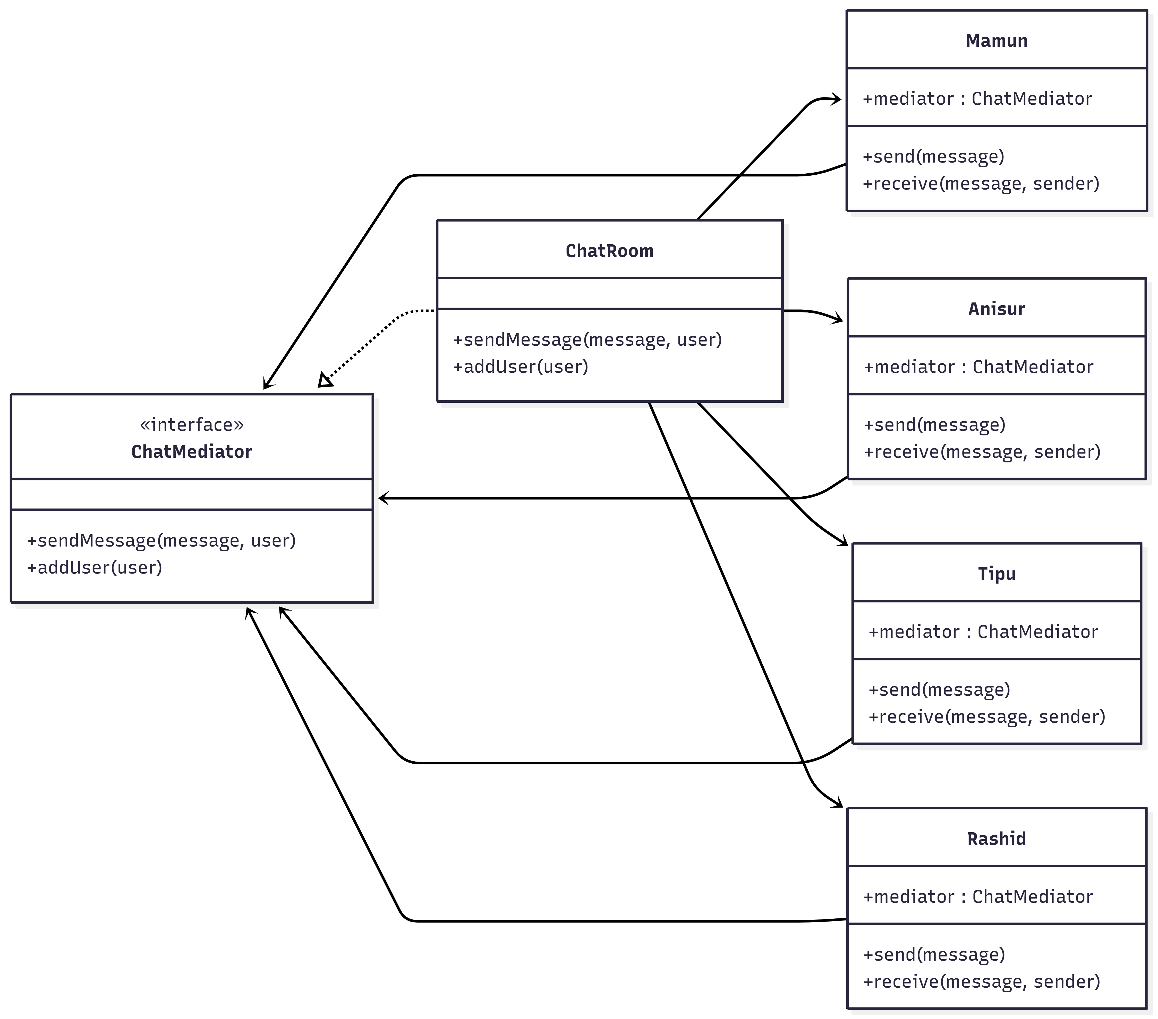
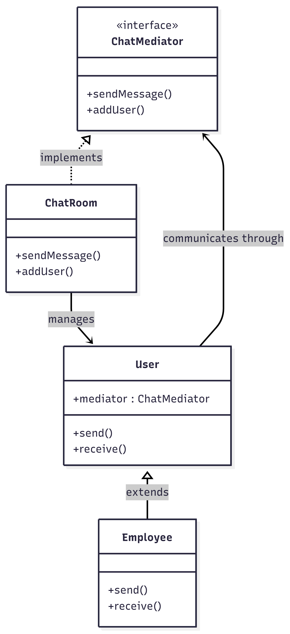
Mediator Pattern
Figure: Mediator Pattern UML Diagram

Slide 42
Structural Design Pattern
Structural Design Patterns are design patterns that deal with how classes and objects are composed to form larger structures. They focus on simplifying relationships between entities, making the system easier to understand and maintain.
Main Purpose:
Simplify structure by identifying relationships
Compose objects to form larger structures
Make systems flexible and easy to modify
Reduce coupling between components
Promote reusability of code
There are 7 types of Structural Design Patterns
Adapter
Bridge
Composite
Decorator
Facade
Flyweight
Proxy

Slide 43
Adapter Pattern
Adapter Pattern is a structural design pattern that allows incompatible interfaces to work together by converting the interface of an existing class into another interface that the client expects. The adapter acts as a bridge between two incompatible interfaces without changing their existing code.
Key Components:
Target Interface - The interface that client expects
Adaptee - The existing class with incompatible interface
Adapter - Converts Adaptee's interface to Target interface
Client - Uses Target interface
When to use:
Enables interoperability between incompatible interfaces
Allows reuse of existing or legacy code
Avoids rewriting large portions of code
Helps integrate third-party libraries smoothly

Slide 44
Adapter Pattern
Benefits:
Promotes code reuse without modification
Keeps classes focused on core responsibility
Supports multiple interfaces via interchangeable adapters
Improves loose coupling
Makes systems easier to modify and extend
Usages:
Integrating incompatible systems
Reusing legacy or third-party code
Supporting multiple data formats
Migrating from old API to new API
Centralizing compatibility logic

Slide 45
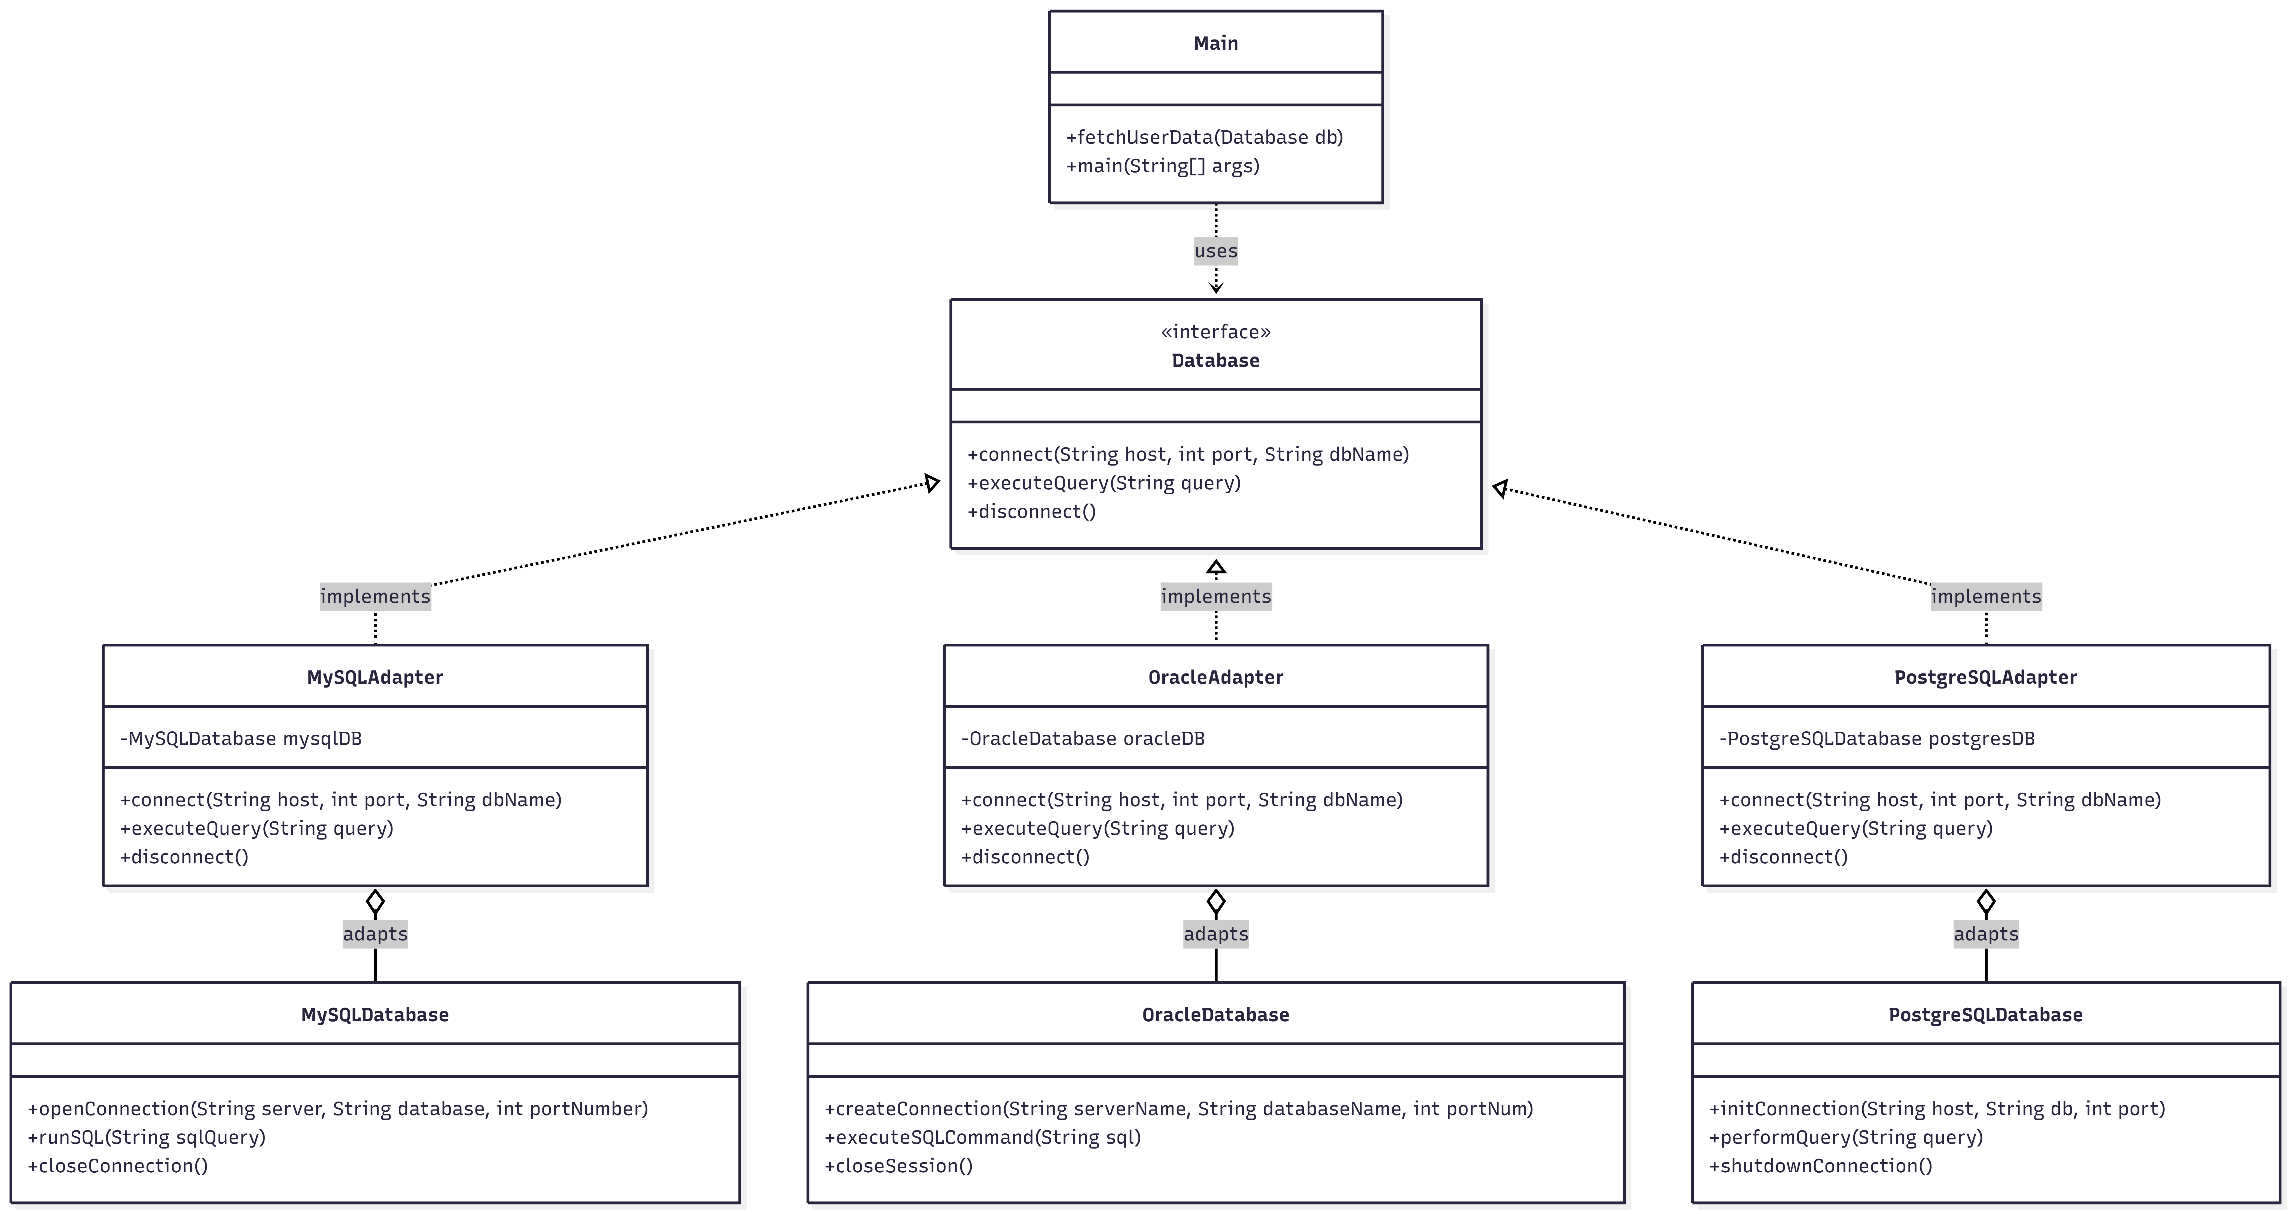
Adapter Pattern
Figure: Adapter Pattern UML Diagram

Slide 46
Bridge Design Pattern
Bridge Pattern separates abstraction from implementation so they can vary independently. It's like a bridge connecting two different hierarchies.
Bridge Pattern separates WHAT you want to do from HOW you do it, so both can change independently without affecting each other.
Benefits:
Separates abstraction from implementation.
Allows both to change independently.
Avoids class explosion from inheritance.
Supports runtime selection of implementation.
Improves flexibility and maintainability.
Usage:
When abstraction and implementation need to change independently.
When multiple dimensions vary (e.g., Shape × Color, Payment × Gateway).
When platform-independent features are required.
When inheritance causes too many subclasses.
When implementation must be selected or changed at runtime.

Slide 47
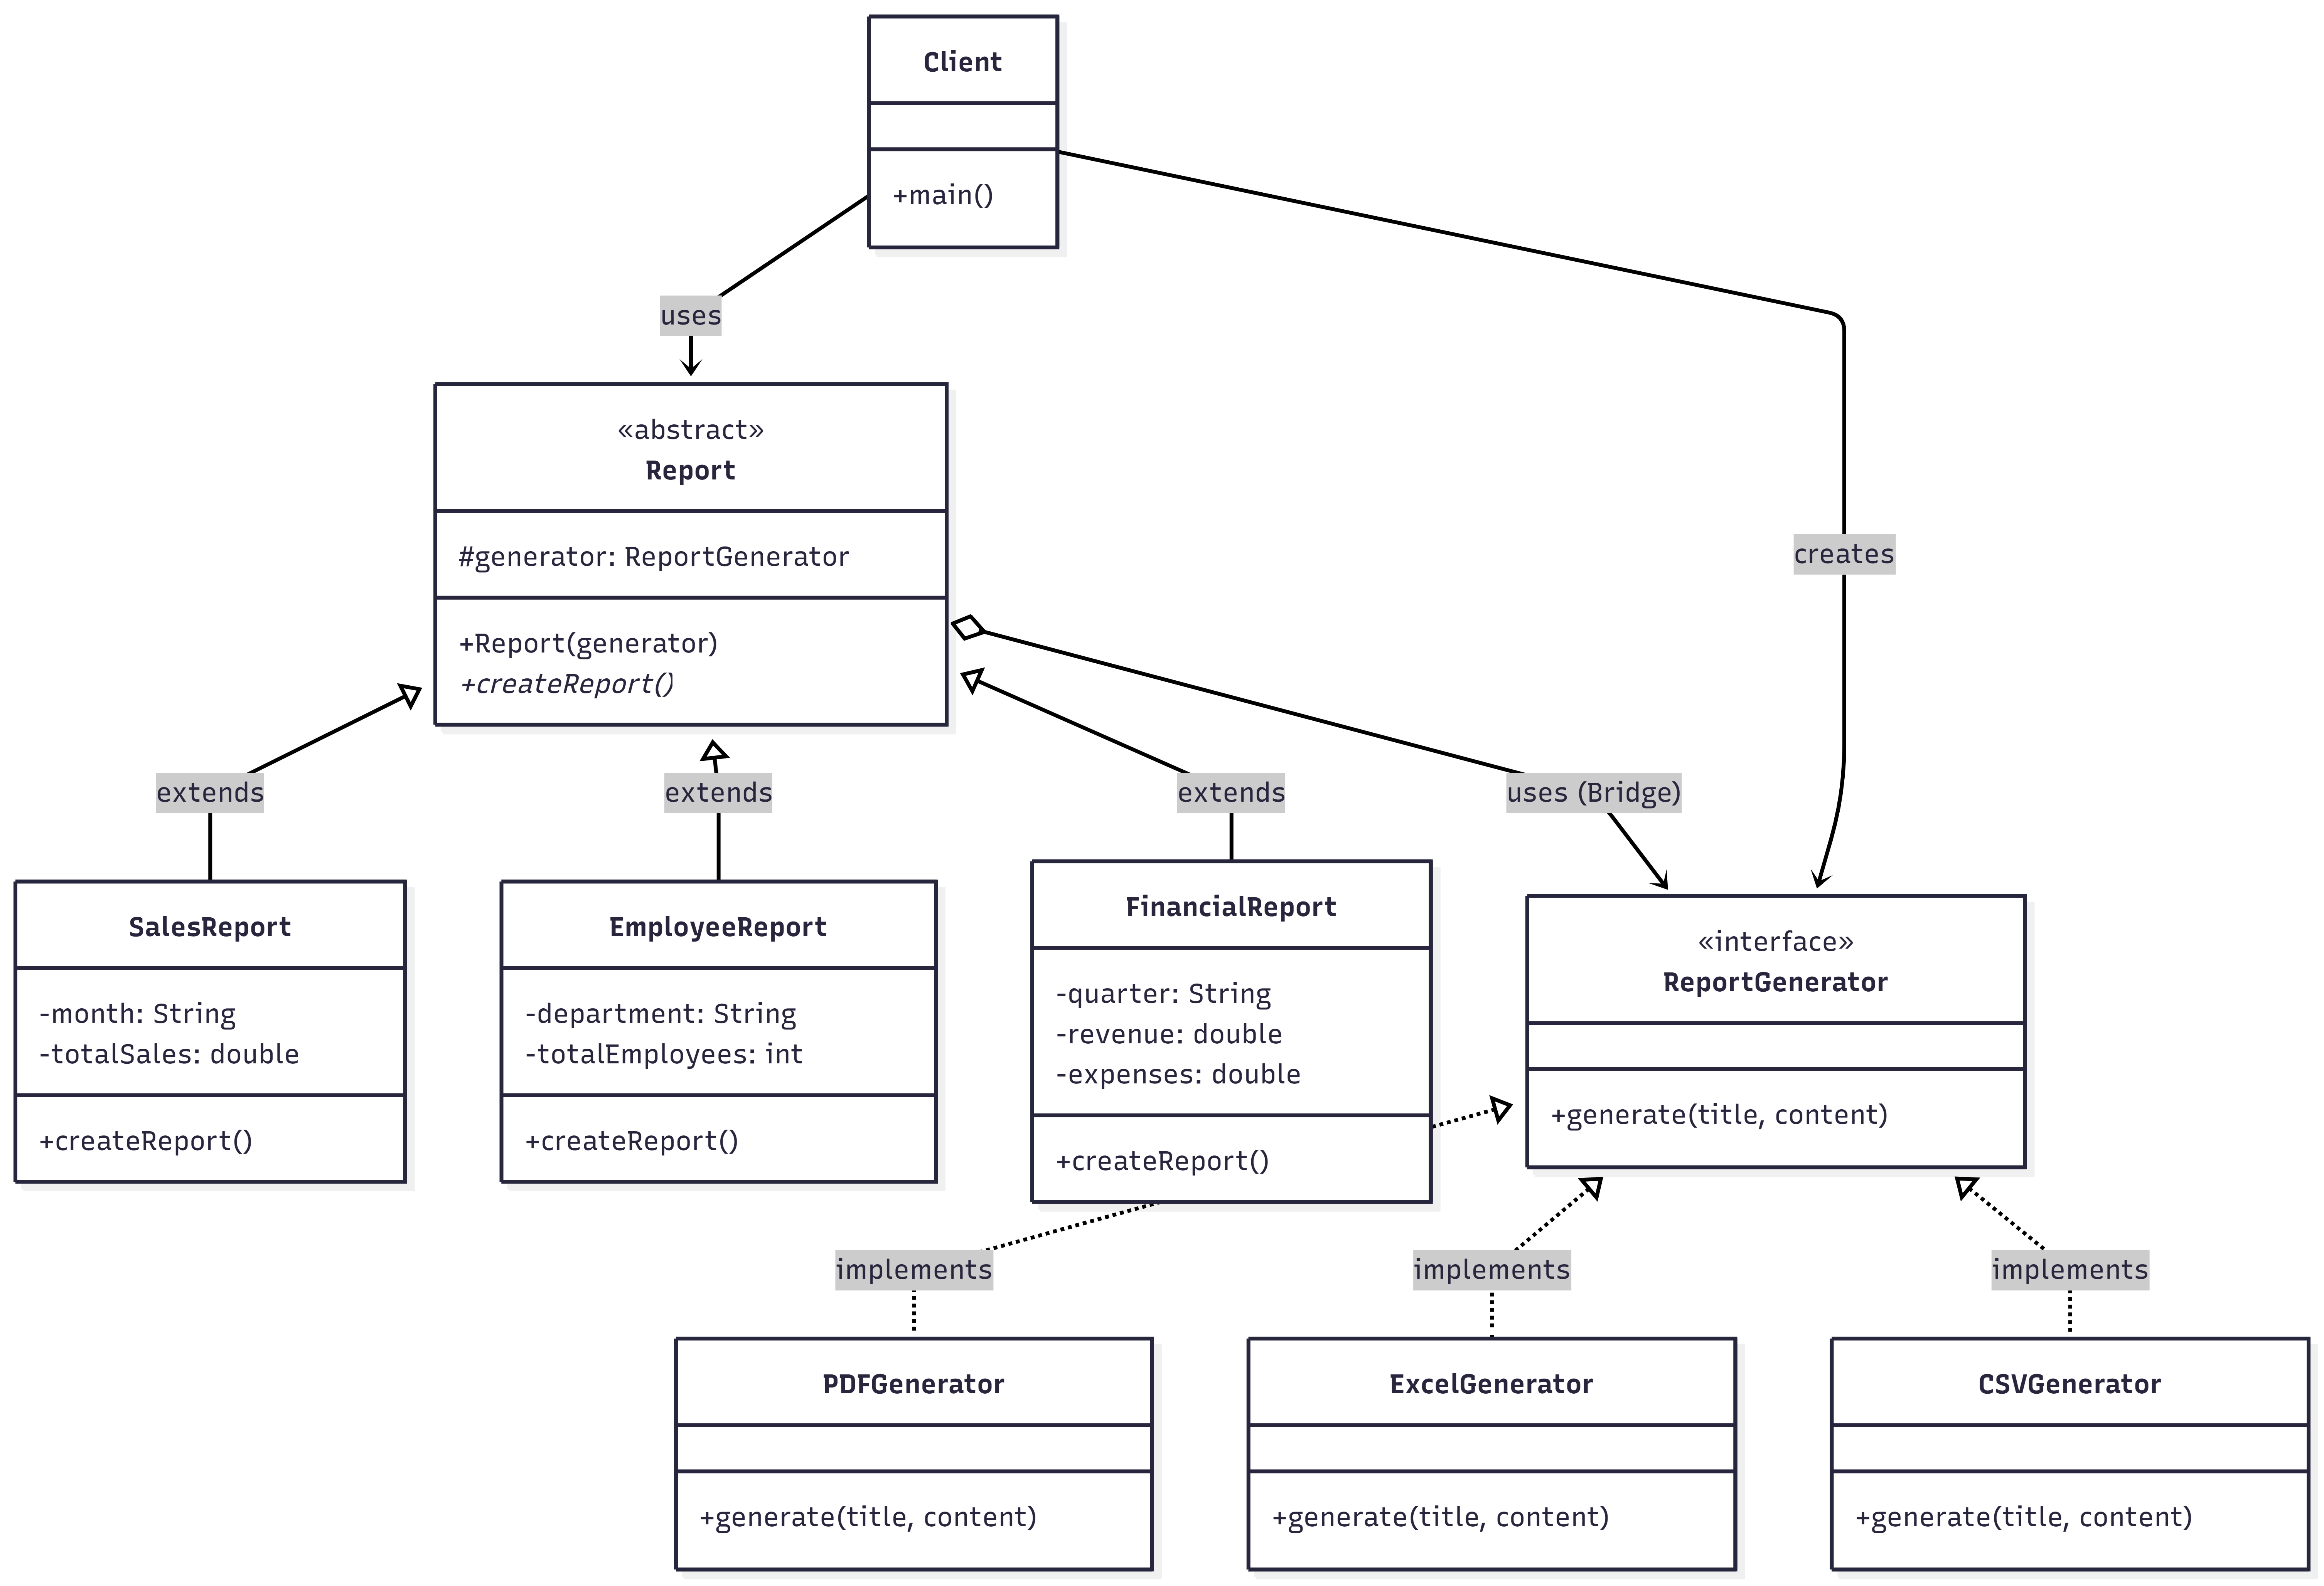
Bridge Pattern
Figure: Bridge Pattern UML Diagram

Slide 48
Composite Pattern
The Composite Pattern is a structural design pattern that allows you to compose objects into tree structures to represent part-whole hierarchies. It lets clients treat individual objects and compositions of objects uniformly.
Benefits:
Simplifies client code by treating single and composite objects the same
Easy to add new components without changing existing code
Naturally represents hierarchies and tree-like structures
Flexible structure that combines simple and composite objects
Each component handles its own operations with single responsibility
Usages:
File system: files & folders
Organization hierarchy: CEO → Managers → Employees → Teams
UI components: windows → panels → buttons/textboxes
Menu systems: main menu → submenus → menu items
Graphics apps: shapes & groups
Document structure: documents → sections → paragraphs

Slide 49
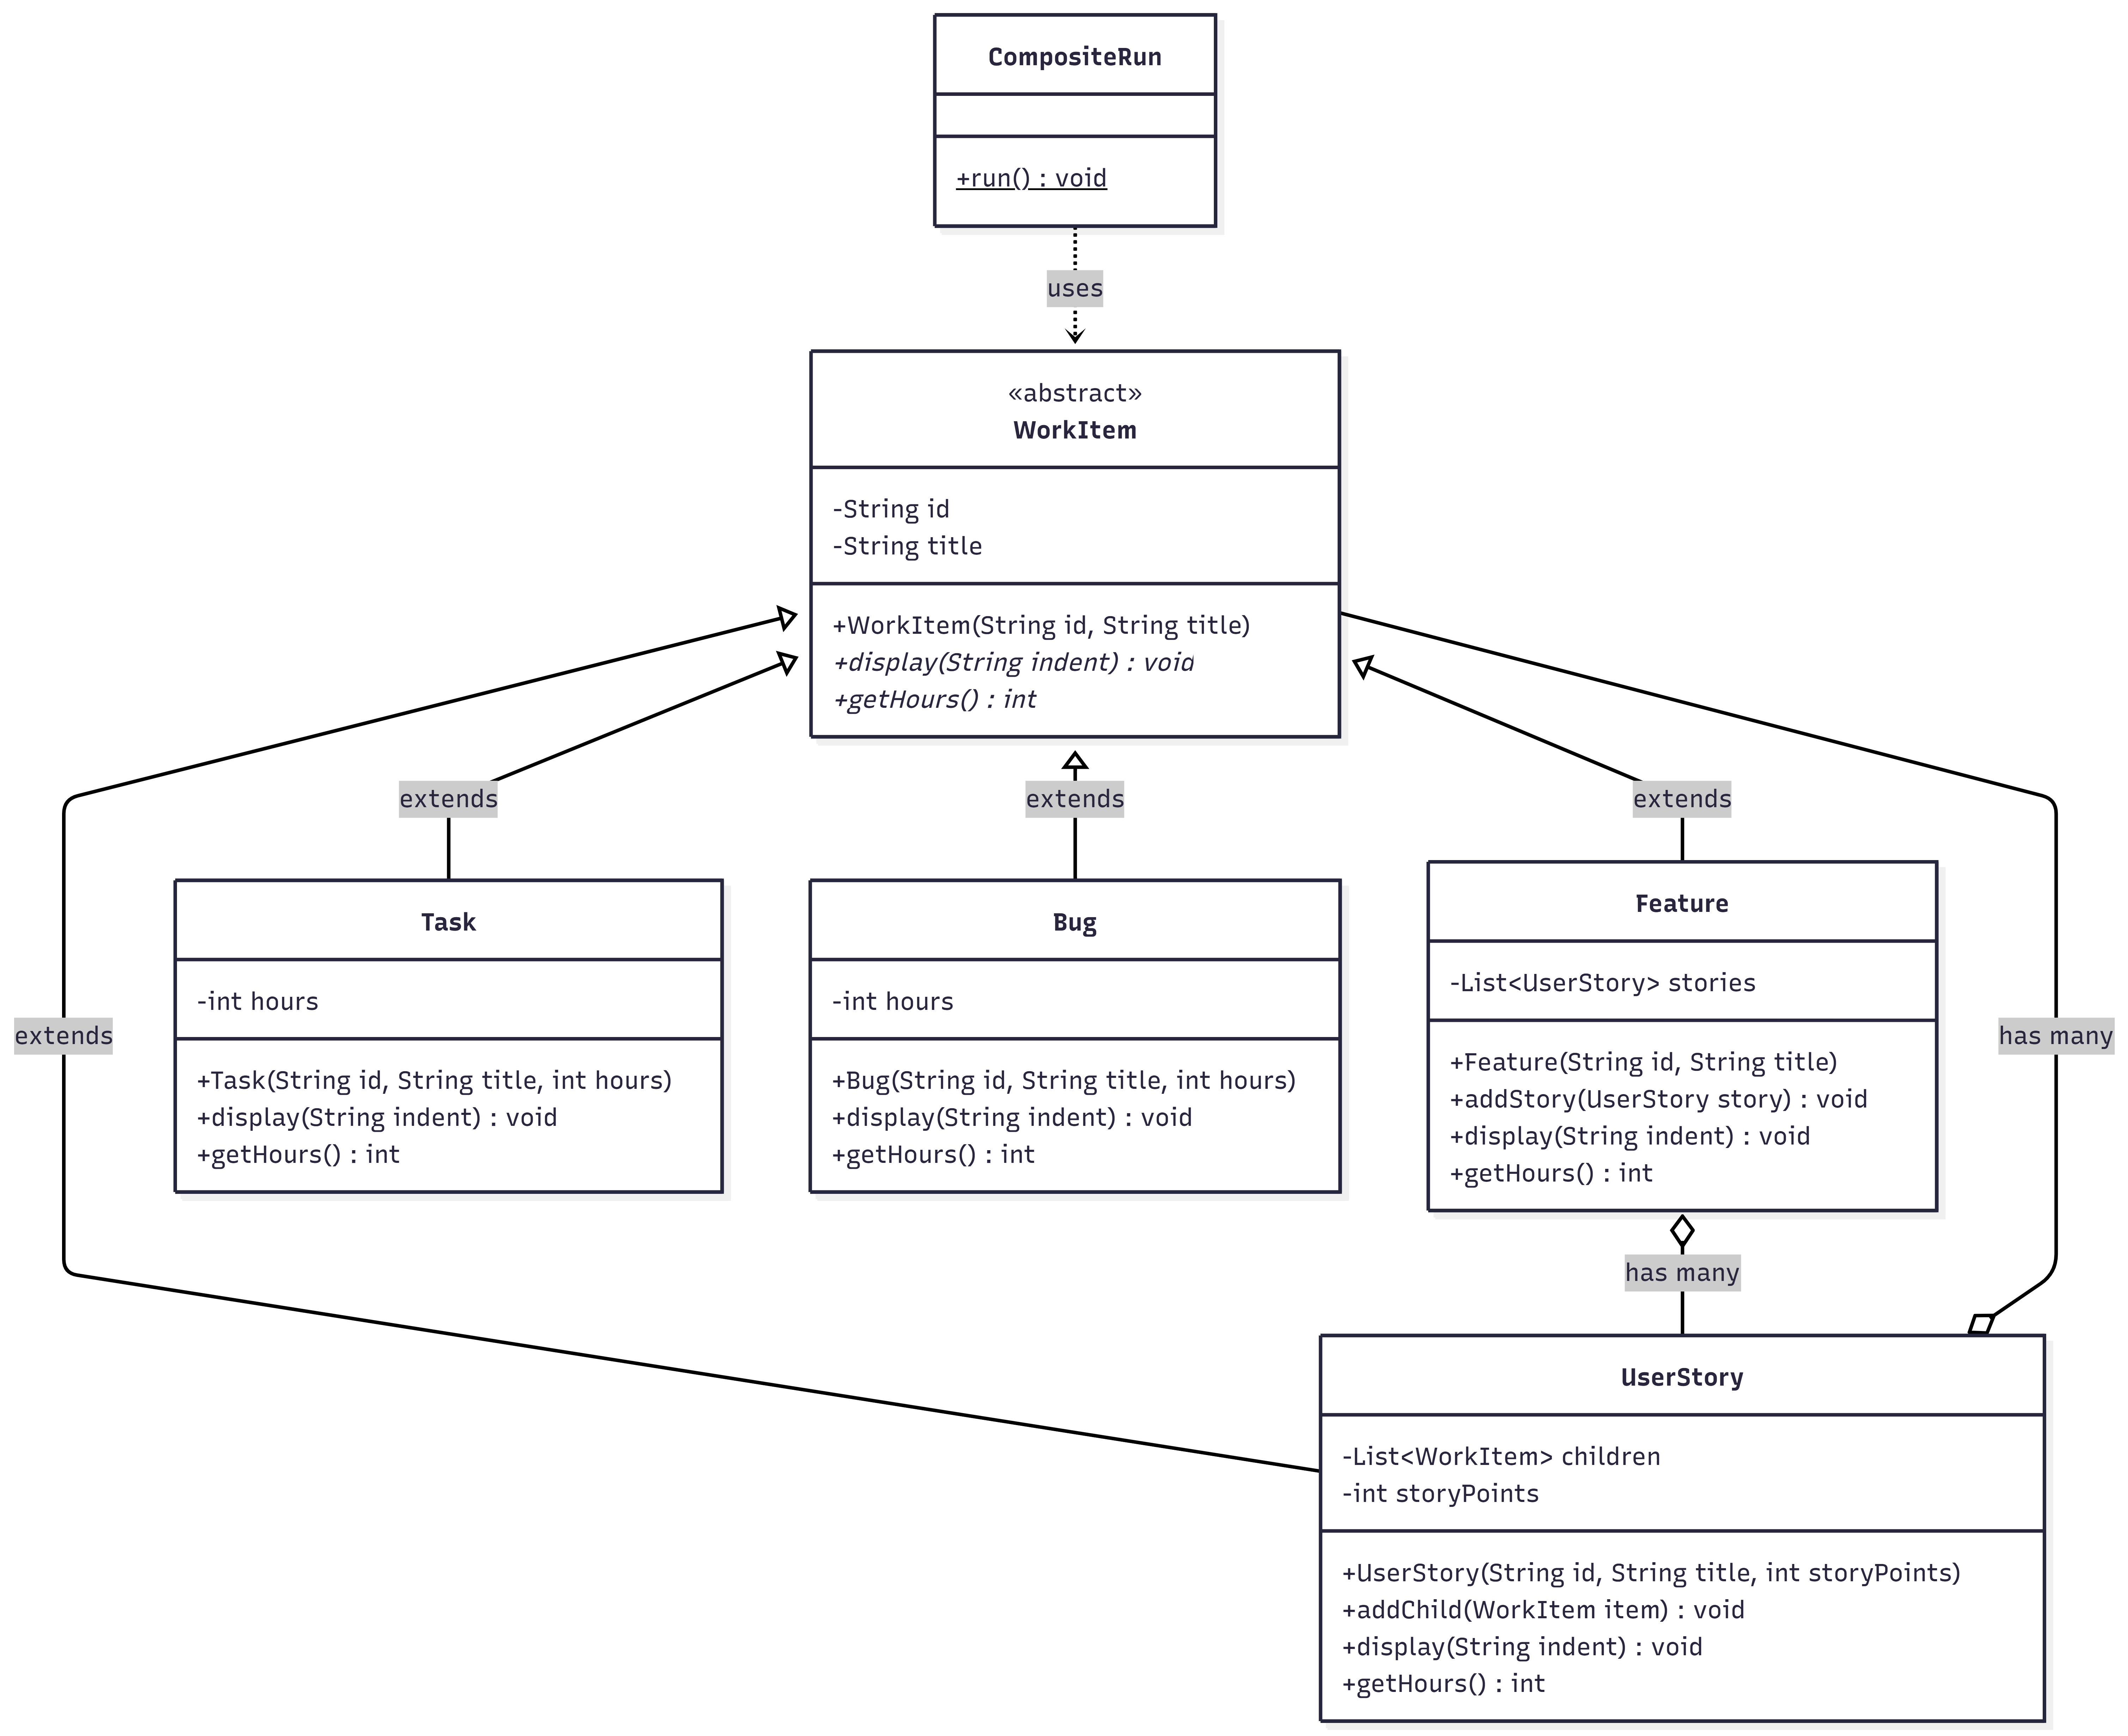
Composite Pattern
Figure: Composite Pattern UML Diagram

Slide 50
Thank you

